Slide 1
Pegasys IPAC Lifecycle
BAAR Phase3 Training

Slide 2
Table of Contents
Segment 1: Intra-Governmental Payment and Collection (IPAC) Overview
Segment 2: IPAC Billing and Outbound File Creation
Segment 3: Update IPAC Status Batch Job
Segment 4: Standard IPAC Inbound Transaction Processing
Segment 5: IPAC Chargebacks
Segment 6: Customer Generated Exceptions
Segment 7: Pulls of Non-IPAC Credits
Segment 8: IPAC Lifecycle Reports

Slide 3
Segment 1:
Intra-Governmental Payment And Collection (IPAC) Overview

Slide 4
Table of Contents
Segment 1: Intra-Governmental Payment and Collection (IPAC) Overview
IPAC Overview and Key Concepts
IPAC Billing Document Refresher
IPAC Refund Itemized Payment Refresher
Segment 2: IPAC Billing and Outbound File Creation
Segment 3: Update IPAC Status Batch Job
Standard 4: Standard IPAC Inbound Transaction Processing
Segment 5: IPAC Chargebacks
Segment 6: Customer Generated Exceptions
Segment 7: Pulls of Non-IPAC Credits
Segment 8: IPAC Lifecycle Reports

Slide 5
Dunning
IPAC Overview and
Key Concepts

Slide 6
IPAC Overview and Key Concepts
Core IPAC Functions
Intra-Governmental Payment and Collection (IPAC) interface
Treasury system facilitating intra-governmental (agency to agency) transfers of funds, which streamlines billing/collections for GSA
IPAC functionality includes 1) an Outbound Process (to Treasury) and 2) an Inbound Process (from Treasury)
GSA bills other agencies via the IPAC system and then receives collection confirmation of those billings from Treasury
Outbound file - contains IPAC Bills and Refund Payments sent from GSA to Treasury
Inbound file - contains IPAC Bill Confirmations/Collections, Customer Push/Pull Payments, and Chargebacks received from Treasury

Slide 7





IPAC Overview and Key Concepts
IPAC Lifecycle Overview
2
3
1
Direct Connect
IPAC Outbound Job
Creates File
In Transit
Process
IPAC Bill Document
Not Submitted
4
Chargebacks
IPAC Transfers Funds
and Sends File Back
Cash Receipt Processed
Confirmed/Received
6
IPAC Inbound Job
Processes Treasury File
5

Slide 8
IPAC Overview and Key Concepts
Typical IPAC Lifecycle Example/Scenario:
GSA is billing another Federal Agency, Department of Justice (DOJ):
DOJ contracts with GSA to procure goods or services
GSA delivers goods or renders services for DOJ
Pegasys submits a bill via IPAC which is processed by Treasury
Pegasys receives notification of collection (i.e. bill confirmation) from Treasury

Slide 9
Dunning
IPAC Billing Document Refresher

Slide 10
IPAC Billing Document Refresher
IPAC Billing Document Overview
Billing Documents (BD):
Record the amount GSA will bill the customer
Establish an outstanding receivable for the customer
Record details regarding the funds owed to GSA
GSA uses BDs to record:
Normal Billing – receivable amounts owed by customers to GSA
For services rendered or goods received, using a Normal Line type
Credit Billing – amounts owed by GSA to customers
Credits for reductions in spending, billing errors, special discounts or changes in recurring billing rates, using a Credit Line type

Slide 11
IPAC Billing Document Refresher (cont.)
IPAC Billing Document Overview
Billing Documents can be generated in one of three ways:
Receive Detail Billing Records from Feeder Systems
Import, Crosswalk, Summarize Detail Billing Records
PCAS Agreement Billing
Establish an Agreement
PCAS Bill Generation Process (PCPROJBILL)
Based on: Spending, Agreement Charges, Flat Rate
Manual Creation
Via new form creation
Option to use Copy From or Copy Forward functionality

Slide 12
IPAC Billing Document Refresher (cont.)
Designated Agent – General Definition
Allows for tracking of the agency that made the purchase from GSA (the customer) and the entity being billed for the purchase (the ALC)
If a customer is associated with an ALC:
IPAC BD Vendor Code = customer vendor code
IPAC BD Designated Agent = Treasury ALC billing address
Designated Agent for AAS and WAN
Designated Agent is NOT ALC for AAS and WAN
Instead will use Vendor Code and Designated Agent on the Billing Document to track BOAC1 and BOAC2
Vendor Code/Vendor Address Code – BOAC2 (the recipient of the goods/services)
Designated Agent Code/Address Code – BOAC1 (the agency paying for the goods/services)

Slide 13
IPAC Billing Document Refresher (cont.)
Designated Agent - IPAC Statements
Group multiple Billing Documents in one consolidated statement at the ALC level via the Designated Agent
Summarization assigns the same Statement Number to IPAC BDs with vendors rolling up to the same Agency Location Code (Designated Agent) within a given run
The Treasury ALC billing address is billed rather than the vendor purchasing goods/services from GSA
IPAC PDF statements can be viewed from VCSS by the Designated Agent or customer vendor
NOTE: AAS/ITS RBA/NBA business lines do NOT group by ALC
One billing record per statement, even if the billing record vendors share the same ALC.

Slide 14
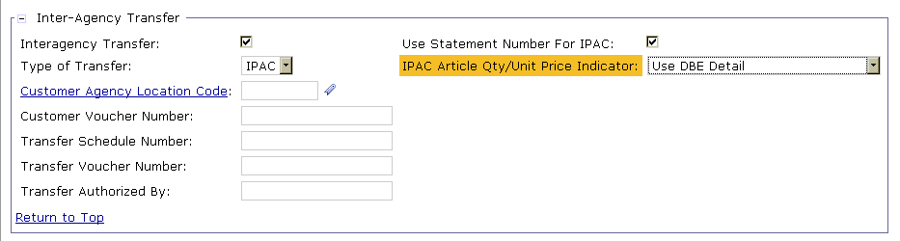
IPAC Billing Document Refresher (cont.)
IPAC Billing Document Overview - Header
Inter-Agency Transfer Section:
IPAC Bills - designated as IPAC by:
Interagency Transfer Flag (checked) on BD header
Type of Transfer (set to IPAC)
The Interagency Transfer flag, Type of Transfer, Use Statement Number for IPAC, and IPAC Article Qty/Unit Price Indicator fields are defaulted based on the IPAC Document Type that is selected

Slide 15
IPAC Billing Document Refresher (cont.)
IPAC Billing Document Overview: Header
IPAC billing can be performed at the DBR level or the accounting line level, which is determined by IPAC Article Qty/Unit Price Indicator:
Use DBE Detail - DBR level billing
Sends information in the IPAC file from a lower level than the Article and Accounting Line (e.g., Telecomm Bill Level Indicator)
Links the information provided on the Article and DBR associated with the BD Accounting Line
Only visible from the IPAC Transaction Query
Use Article Quantity/Unit Price – Article (accounting line) level billing
Send information in the IPAC file from the Article and accounting line
Transaction information will be sent for each individual accounting line

Slide 16
IPAC Billing Document Refresher (cont.)
IPAC Billing Document Overview: Header
IPAC Article Qty/Unit Price Indicator defaults for Phase 3 Business Lines using Document Type extensibility
Defaulted IPAC Article Qty/Unit Price Indicator
Use DBE Detail | Use Article Qty/Unit Price
National Assisted Acquisition Services-FEDSIM | R6 Manual Business Line
Regional Assisted Acquisition Services | External Services
Integrated Workplace Acquisition Center (IWAC)
Regional Network Services-Expanded Services
HSPD-12
National IT Commodity Program
Regional Network Services-Telecom
Wide Area Network

Slide 17
IPAC Billing Document Refresher (cont.)
IPAC Billing Document Overview: Articles
IPAC Billing Documents contain "Articles"
Articles capture:
Information to be included in the IPAC file:
Commodity/Unit information
Quantity
Unit Price Amount
IPAC Status
Used to determine the state of the IPAC transaction within the IPAC lifecycle, e.g., Not Submitted, In Transit, Confirmed, etc.
Both Articles and Detail Billing Records are linked to the Accounting line, but there is no direct link between Articles and Detail Billing Records

Slide 18
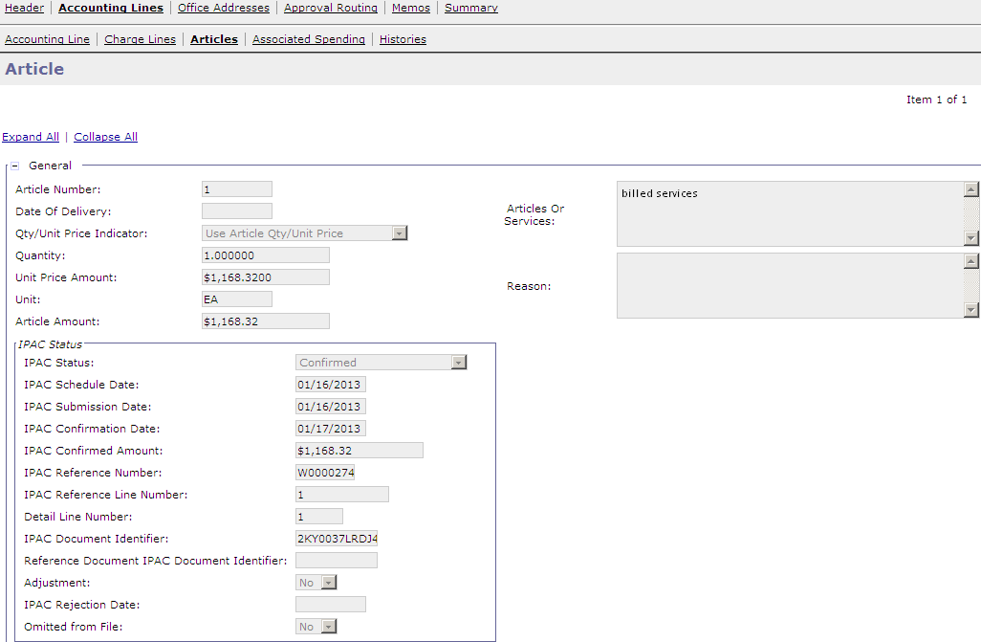
IPAC Billing Document Refresher (cont.)
IPAC Billing Document Overview: Articles

Slide 19
IPAC Billing Document Refresher (cont.)

Slide 20
IPAC Billing Document Refresher (cont.)
IPAC Billing Document Overview: DBRs
Detail Billing Records provide both financial data and non-financial (i.e. GSA Order Number) billing detail used to:
Generate/process Pegasys billing transactions
Note: DBRs do not directly post to the GL
Create customer statements documenting the goods or services provided
DBRs can be received from external feeder systems and are used to create BDs, summarizing “like” data records into documents and accounting lines
Pegasys Detail Billing Record Table:
Detail Billing Records are stored on the Detail Billing Record Table within Pegasys
Contains 200+ fields to store GSA specific data that is not stored on the document header or accounting line

Slide 21
IPAC Billing Document Refresher (cont.)

Slide 22
Dunning
IPAC Refund Itemized Payment Refresher

Slide 23
IPAC Refund Itemized Payment Refresher
IPAC Refund Itemized Payment documents can be created via:
Manually: Accounts Payable → New → Payment Authorization
Automatically: Automated Credit Application (ARCRDAPP)
The majority of IPAC Refund IPs are generated via the ARCRDAPP batch process

Slide 24
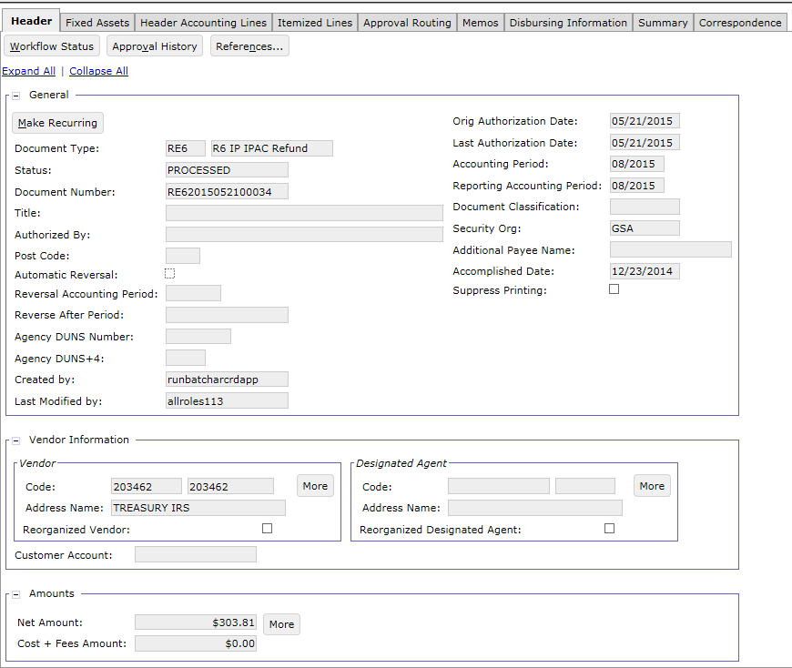
IPAC Refund Itemized Payment Refresher Header

Slide 25
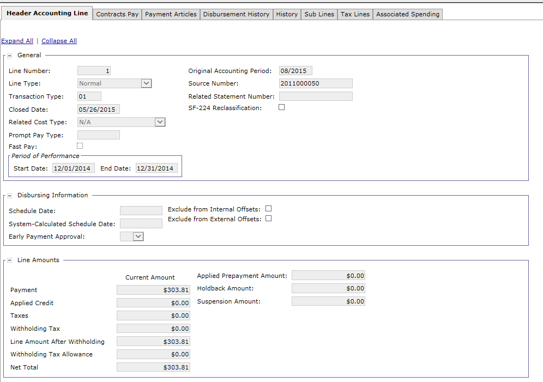
IPAC Refund Itemized Payment Refresher Accounting Line

Slide 26
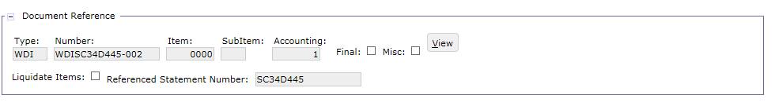
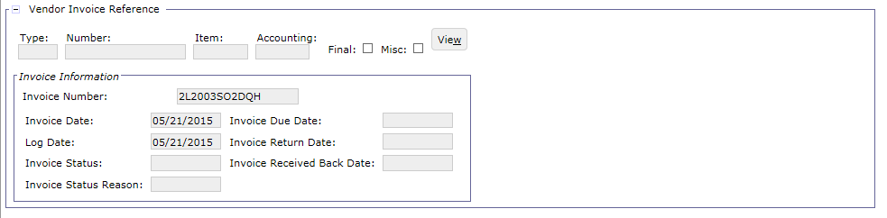
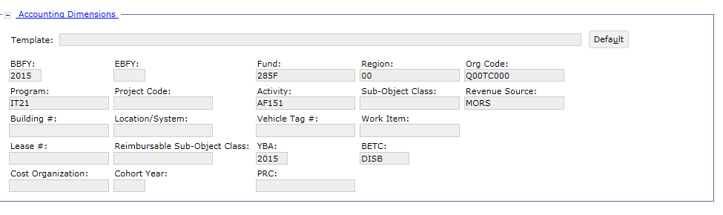
IPAC Refund Itemized Payment Refresher Accounting Line

Slide 27
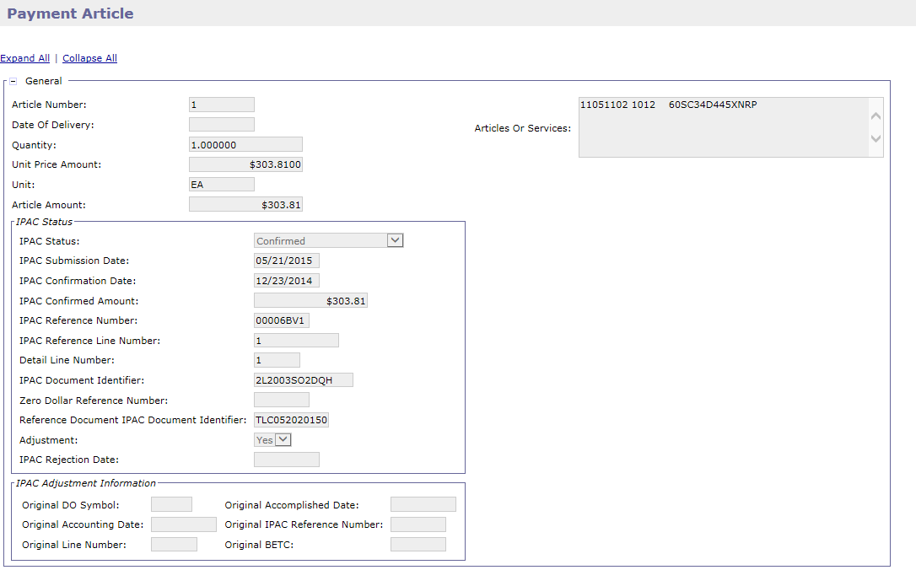
IPAC Refund Itemized Payment Refresher Payment Article

Slide 28
Segment 2:
IPAC Billing and Outbound File Creation

Slide 29
Table of Contents
Segment 1: Intra-Governmental Payment and Collection (IPAC) Overview
Segment 2: IPAC Billing and Outbound File Creation
Outbound File Inputs
IPAC Outbound Batch Job
Bill Generation
IPAC Transaction Query
IPAC Treasury Rejections
Segment 3: Update IPAC Status Batch Job
Standard 4: Standard IPAC Inbound Transaction Processing
Segment 5: IPAC Chargebacks
Segment 6: Customer Generated Exceptions
Segment 7: Pulls of Non-IPAC Credits
Segment 8: IPAC Lifecycle Reports
29

Slide 30
Dunning
Outbound File Inputs

Slide 31
IPAC Outbound File Inputs: IPAC Billing Documents
IPAC Billing Documents can be generated in one of three ways:
Receive Detail Billing Records from Feeder Systems
Import, Crosswalk, Summarize batch jobs
PCAS Agreement Billing
PCAS Bill Generation (PCPROJBILL) batch job
Manual Creation
Via new form creation
Option to use Copy From or Copy Forward functionality

Slide 32
Outbound File Inputs: IPAC Refund Itemized Payments
Automated Credit Application Overview:
IPAC Credits:
Automated Credit Application batch job will generate refund payments for IPAC credit Billing Documents
The Automated Credit Application batch job (ARCRDAPP) provides the ability to:
Apply credit amounts within a bill, an agreement, a statement, or a customer
Refund credit amounts back to the customer
For IPAC transactions, ARCRDAPP will only refund credit amounts back to the customer

Slide 33
Outbound File Inputs: IPAC Refund Itemized Payments
Automated Credit Application Overview:
Credits are created in the following ways:
Summarization Batch Process – summarizes credit Detail Billing Records from feeder systems and generates Billing Documents with Credit line type
PCAS Bill Generation Batch Process – reviews spending/agreement charges to determine if a Billing Document with Credit line type should be created
Manually – Pegasys user generates Billing Document with Credit line type
IPAC Refund Itemized Payments: Itemized Payments
Sent to Treasury via IPAC to record refund of customer credit

Slide 34
Dunning
IPAC Outbound Batch Job

Slide 35
IPAC Outbound Batch Job – IPAC Outbound Functionality Overview
2
3
1
Direct Connect
IPAC Outbound Job
Creates File
In Transit
Process
IPAC Bill Document
Not Submitted
4
Chargebacks
IPAC Transfers Funds
and Sends File Back
Cash Receipt Processed
Confirmed/Received
6
IPAC Inbound Job
Processes Treasury File
5

Slide 36
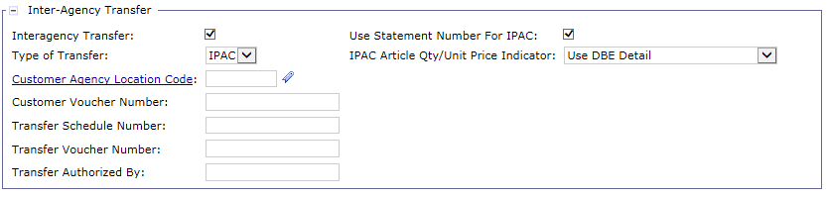
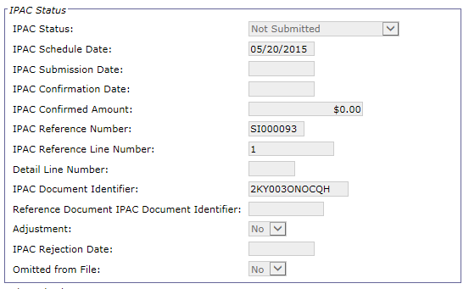
IPAC Outbound (GSIPACOUT) Batch Job: Functionality Overview
The IPAC Outbound batch process (to Treasury) selects billing and payment transactions in the system and creates an upload file
IPAC Bills are selected for IPAC via the following selection criteria:
Document Status = Processed
BD Header Interagency Transfer Flag = checked (true)
BD Header Type of Transfer = IPAC
Defaulted when IPAC Document Type is selected
IPAC Status = Not Submitted

Slide 37
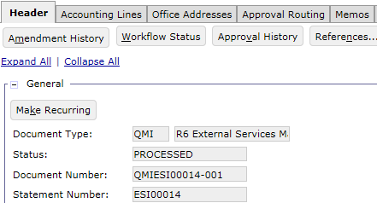
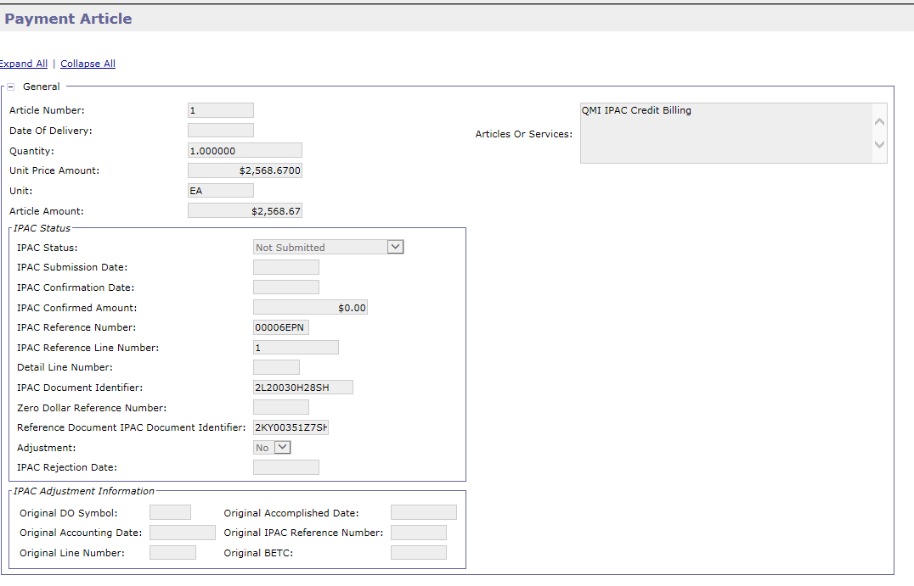
IPAC Outbound (GSIPACOUT) Batch Job: Functionality Overview
IPAC Itemized Payments are selected for IPAC via the following:
Document Status = Processed
IPAC Status = Not Submitted

Slide 38
IPAC Outbound (IPACOUT) Batch Job: Functionality Overview
The IPAC Outbound batch process creates a file for Treasury using the Treasury Defined IPAC Bulk Layout
IPACOUT process can be run in Preliminary or Final Mode
IPACOUT Preliminary Mode:
Validates Statements are complete with no Rejected documents
Business lines that send Statement Numbers to Pegasys may not want to send incomplete Statements to Treasury
“Override Readiness Check” Parameter is set to True in Final Mode to prevent (or in some special cases, submit) partial Statements
Enables error checking pre-billing
Can be performed before IPACOUT’s final mode
IPACOUT Final Mode:
Generates the IPAC Outbound file that is transmitted to Treasury
IPACOUT for GSA is run in Final Mode and with Override Readiness Check set to False by default

Slide 39
IPAC Outbound Batch Job – IPAC Outbound File Layout – AAS/ITS
The IPAC Outbound batch process creates a file for Treasury using the Treasury Defined IPAC Bulk Layout
The following is a mapping of IPAC File, Pegasys Billing Document Fields and AAS/ITS values
IPAC File | Billing Document Field | AAS/ITS Value
Purchase Order Number | Accounting Line – Customer Funding Source | Blank (not populated in IPAC Bulk File)
Obligating Document Number | Accounting Line – Funding Authorization Source | RBA/NBA Funding Document Number
Contract Number | Accounting Line – Contract Number | AASFEDSIM, AASREGIT, IWAC, ITSEXPSER, ITSHSPD12, ITSNATITCM
Requisition Number | Accounting Line – Requisition Number | "NA"
Accounting Classification Code | Accounting Line – Accounting Classification Code | Billing Office Address Code (BOAC 1)
Accounting Classification Reference Number | Accounting Line – Accounting Classification Reference Number | [Task Order/Cust. ID] + [Subtask] [Subtask] is not used for NBA, so this field will contain only [Task Order/Cust. ID] for NBA
JAS Number | Accounting Line – JAS Number | Agency
Invoice Number | Article – IPAC Document identifier | 12 digit system generated number
Unit of Issue | Article – Unit of Issue | EA
IPAC Document Reference Number | Article – IPAC Document Reference Number | Pegasys Statement Number
Articles and Services | Article – Articles and Services | Customer Purchase Order

Slide 40
IPAC Outbound Batch Job – IPAC Outbound File Layout – Telecom/WAN
The following is a mapping of IPAC File, Pegasys Billing Document Fields and Telecom/WAN values
IPAC File | Billing Document Field | Telecom/WAN
Purchase Order Number | Accounting Line – Customer Funding Source | Blank (not populated in IPAC Bulk File)
Obligating Document Number | Accounting Line – Funding Authorization Source | "NOT_PROVIDED"
Contract Number | Accounting Line – Contract Number | ITSREGTEL, ITSWAN
Requisition Number | Accounting Line – Requisition Number | "NA"
Accounting Classification Code | Accounting Line – Accounting Classification Code | TOPS/WITS: “T-“ + [Customer Number BOAC] E-MORRIS: [BOAC1]
Accounting Classification Reference Number | Accounting Line – Accounting Classification Reference Number | TOPS/WITS: "NA" E-MORRIS: [Task Order/Cust. ID] + [Subtask]
JAS Number | Accounting Line – JAS Number | [Agency] + [Bureau]
Invoice Number | Article – IPAC Document identifier | 12 digit system generated number
Unit of Issue | Article – Unit of Issue | EA
IPAC Document Reference Number | Article – IPAC Document Reference Number | Pegasys Statement Number
Articles and Services | Article – Articles and Services | TOPS/WITS: Customer LOA E-MORRIS: Customer LOA + Additional Detail Elements

Slide 41
IPAC Outbound Batch Job – IPAC Outbound File Layout – Manual Business Line
The following is a mapping of IPAC File, Pegasys Billing Document Fields and Manual Business Lines values
IPAC File | Billing Document Field | Manual Business Lines
Purchase Order Number | Accounting Line – Customer Funding Source | Customer PO# or Funding Information
Obligating Document Number | Accounting Line – Funding Authorization Source | agreement number or funding document
Contract Number | Accounting Line – Contract Number | R6MANUAL
Requisition Number | Accounting Line – Requisition Number | IAA #
Accounting Classification Code | Accounting Line – Accounting Classification Code | Vendor Code
Accounting Classification Reference Number | Accounting Line – Accounting Classification Reference Number | PCAS Agreement Number (for business lines using PCAS Agreements) or Vendor Address Code (for business lines NOT using PCAS agreements)
JAS Number | Accounting Line – JAS Number | MBL
Invoice Number | Article – IPAC Document identifier | 12 digit system generated number
Unit of Issue | Article – Unit of Issue | EA
IPAC Document Reference Number | Article – IPAC Document Reference Number | Pegasys Statement Number
Articles and Services | Article – Articles and Services | Customer’s Line of Accounting (LOA)

Slide 42
IPAC Outbound Batch Job – IPAC Outbound File Layout – External Services
The following is a mapping of IPAC File, Pegasys Billing Document Fields and External Services values
IPAC File | Billing Document Field | External Services
Purchase Order Number | Accounting Line – Customer Funding Source | Customer PO# or Funding Information
Obligating Document Number | Accounting Line – Funding Authorization Source | agreement number or funding document
Contract Number | Accounting Line – Contract Number | EXTSERVICE
Requisition Number | Accounting Line – Requisition Number | IAA #
Accounting Classification Code | Accounting Line – Accounting Classification Code | Vendor Code
Accounting Classification Reference Number | Accounting Line – Accounting Classification Reference Number | PCAS Agreement Number (for business lines using PCAS Agreements) or Vendor Address Code (for business lines NOT using PCAS agreements)
JAS Number | Accounting Line – Student Name | Student Name
Invoice Number | Article – IPAC Document identifier | 12 digit system generated number
Unit of Issue | Article – Unit of Issue | EA
IPAC Document Reference Number | Article – IPAC Document Reference Number | Pegasys Statement Number
Articles and Services | Article – Articles and Services | Customer’s Line of Accounting (LOA)

Slide 43
IPAC Outbound Batch Job: Document Updates
Billing Document Updates
Billing Status - Accounting line level indicator indicates which GL postings should occur (Billed or Unbilled)
Set to “Billed” by IPAC Outbound
Triggers update from Unbilled (131000.07) to Billed (131000.08)
IPAC Status - Article level indicator
Multiple values corresponding to different states in the IPAC lifecycle process
Set to “In Transit” by IPAC Outbound
Statement Generated Flag - Billing Document Header flag that when checked sends the BD information to VCSS
Set to T by IPAC Outbound
Itemized Payment Updates
IPAC Status – Article level indicator
Set to “In Transit” by IPAC Outbound

Slide 44
Dunning
Bill Generation

Slide 45
Bill Generation: Overview
Bill Generation (ARBILLGEN)
Allows GSA to automatically select and prepare bills for printing
Updates Billing Documents
Auto-executes the Bill Generation report

Slide 46
Bill Generation (ARBILLGEN) Process
Transactions are selected for the ARBILLGEN process based on:
Criteria on the Billing Document
Bill Print Date, Last Bill Print Date, and Collection Due Date are blank
Bill Print Flag
If equals Yes, a PDF will be generated
If equals Suppress, a PDF will NOT be generated
The ARBILLGEN batch process makes the following updates to the Billing Document:
Populates Billing dates
Sets the Collection due date
Indicates that IPAC bills have been generated/sent to customer
Bill Print Date, Last Bill Date – set to “Print Date” parameter by ARBILLGEN
Last Bill Amount- Set to outstanding line amount

Slide 47
Bill Generation (ARBILLGEN) Process
The ARBILLGEN batch process creates the Billing Statement PDF
Auto-executes the Bill Generation report, which produces the individual bills and a consolidated file containing all the bills in the batch run
The ARBILLGEN batch process transmits the generated PDF Billing Statement to Vendor Customer Self Service (VCSS)
The PDF is automatically transmitted to VCSS ONLY if the customer is setup to view/receive bills in VCSS

Slide 48
Dunning
IPAC Transaction Query

Slide 49
IPAC Transaction Query: Overview
Navigate to Queries → General System → IPAC Transaction Query to view the IPAC Transaction Query
IPAC Transaction Query
Allows users to research and review transactions sent to IPAC via the IPAC Outbound process and created by the IPAC Inbound Batch Process
Billing Documents: sent to Treasury via IPAC to bill customers for goods/services rendered
Itemized Payments: sent to Treasury via IPAC to refund credits owed to customers
Allows users to perform the following actions directly through the
Find Rejected Documents
Search by IPAC Status
Update IPAC Status (in bulk)
Create Correspondence from IPAC Transaction Query
Generate Write-offs
Note: IPAC Transaction Query for Cash Receipts is presented in Segment 4 of this training course.

Slide 50
IPAC Transaction Query: Overview
IPAC Transaction Query provides information on:
Transaction Details
IPAC History
Standard General Ledger (SGL) Information
IPAC Transaction DBE Details
Transactions Included | Transactions Not Included
Billing Documents – Normal/Advance Lines IPAC Itemized Payments (IM6/7, RE6/7, CB6/7, RY7, MI6) IPAC Cash Receipts – Normal/Advance Lines (IR6/7) IPAC Cash Receipts – Debit Voucher Lines (DR6/7) | IPAC Billing Document Credits (although it will show the IP documents that created the credit) Internal Vouchers

Slide 51
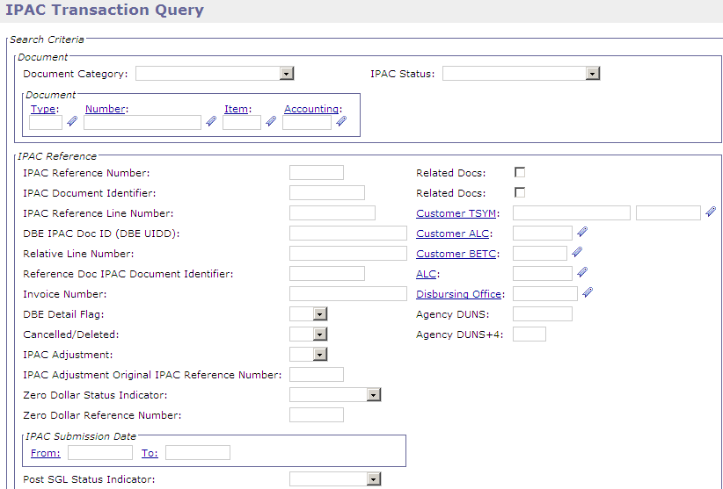
IPAC Transaction Query – Search Criteria

Slide 52
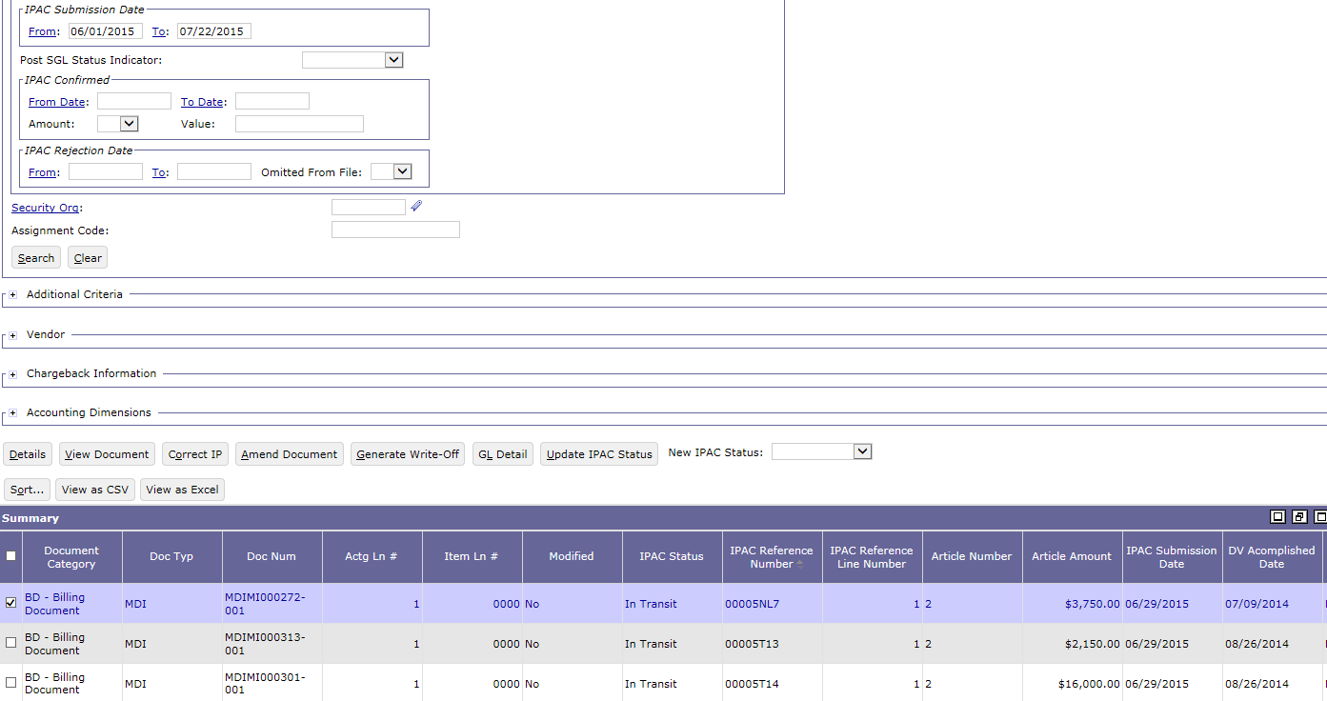
IPAC Transaction Query – Search Criteria and Results

Slide 53
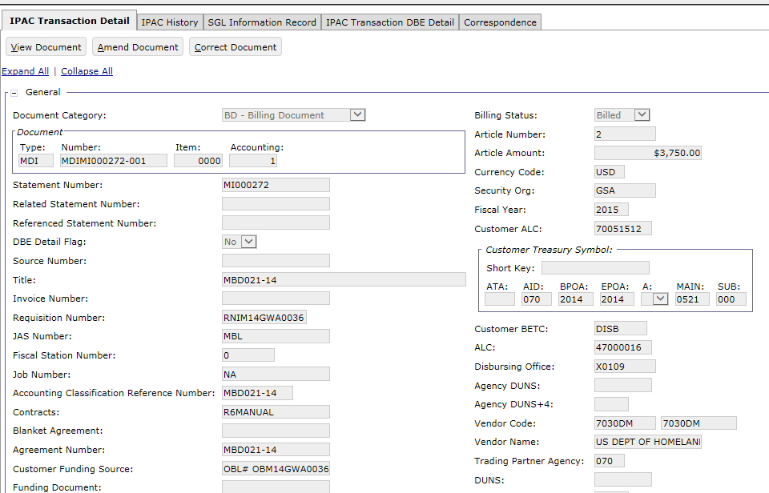
IPAC Transaction Query – IPAC Transaction Detail Billing Document

Slide 54
IPAC Transaction Query – IPAC Transaction Detail
Field Name | Description
Statement Number | The unique number used to associate related Billing Documents when generating the printed bill for customers.
DBE Flag | A drop-down box with valid options of Yes or No indicating whether to show the detail billing element detail.
Requisition Number | The requisition number used for interagency transfers.
JAS Number | A number that is a combination of Job Order number, Accounting Classification Record number and Site ID, used for interagency transfers.
Fiscal Station Number | The fiscal station number used for interagency transfers.
Accounting Classification Reference Number | The accounting classification reference number used for interagency transfers.
Contract | The number for the receivable. If entered, this value must be a valid item associated with the vendor on the Contract maintenance table.
Agreement Number | The agreement number associated with this form.
Customer Funding Source | The customer's method of payment (e.g. credit card, eCheck, etc.).
Billing Status | An editable drop-down with Billing status values Billed or Unbilled for the document.
Article Number | The number of the article associated with the document.
Article Amount | The amount of the article associated with the document(s). Calculated for all transactions except when the IPAC Article Qty Unit Price indicator is set to Use DBE Detail. Stored for Use DBE Detail BDs.
Vendor Code | The vendor code that defines this vendor to the system.

Slide 55
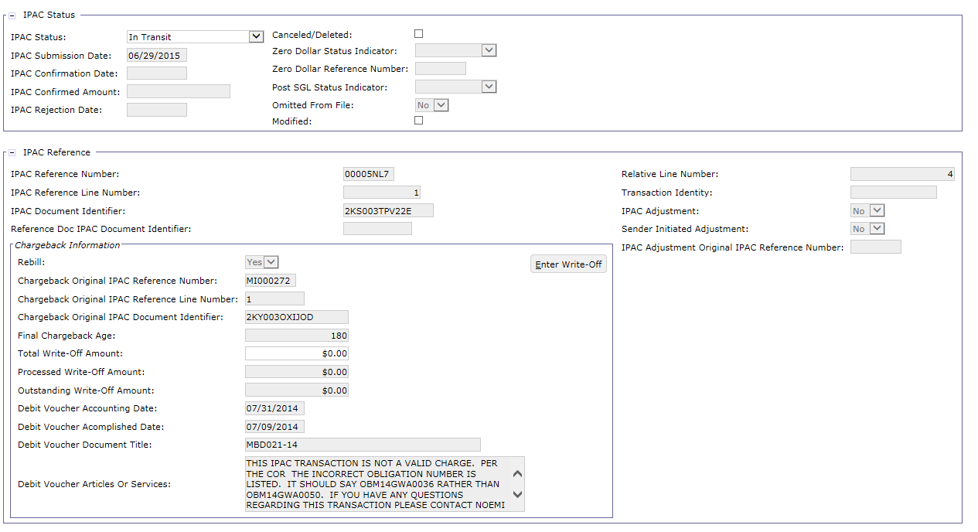
IPAC Transaction Query – IPAC Transaction Detail Billing Document

Slide 56
IPAC Transaction Query – IPAC Transaction Detail
Field Name | Description
IPAC Status | Refers to the status of the document and its interaction with the IPAC Interface. Valid values include: Not Submitted, Confirmed, In Transit, Received, Pending, Hold – Pending Chargeback, Rejected, Do Not Send, Write Off
IPAC Submission Date | The Date the amount is submitted to IPAC for action.
IPAC Reference Number | The Reference Line Number generated to which the transaction is mapped.
IPAC Document Identifier | An automatically generated number that uniquely identifies the associated document line or article and is used by the IPAC Inbound process.
Rebill | Indicates the system processed billing document as a result of an IPAC Rebill transaction (where a Debit Voucher referencing a Cash Receipt that references the Billing Document has been created).
Chargeback Original IPAC Reference Number | A unique automatically generated text field that is populated when the user verifies and/or the system processes a billing document as a result of an IPAC Rebill transaction.
Final Chargeback Age | Shows the age of the Chargeback
Debit Voucher Accounting Date | Stores the Document Date from the Debit Voucher CR. For BD rebill articles the value is taken from the referencing Debit Voucher CR.
Debt Voucher Accomplished Date | Stores the Accomplished Date from the Debit Voucher CR. For BD rebill articles the value is taken from the referencing Debit Voucher CR.
Debit Voucher Document Title | Stores the Document Title from the Debit Voucher CR. For BD rebill articles the value is taken from the referencing Debit Voucher CR
Debit Voucher Article/Service | Stores the value from the Article or Services field off of the Debit Voucher CR article. For BD rebill articles the value is taken from the referencing Debit Voucher CR.

Slide 57
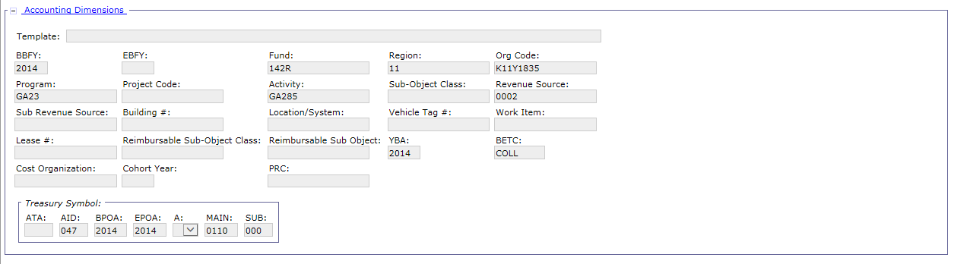
IPAC Transaction Query – IPAC Transaction Detail Billing Document
Field Name | Description
Accounting Dimensions | Includes the BBFY, Fund, Region, Org Code, Program, Activity, SOC, RSC, etc.

Slide 58
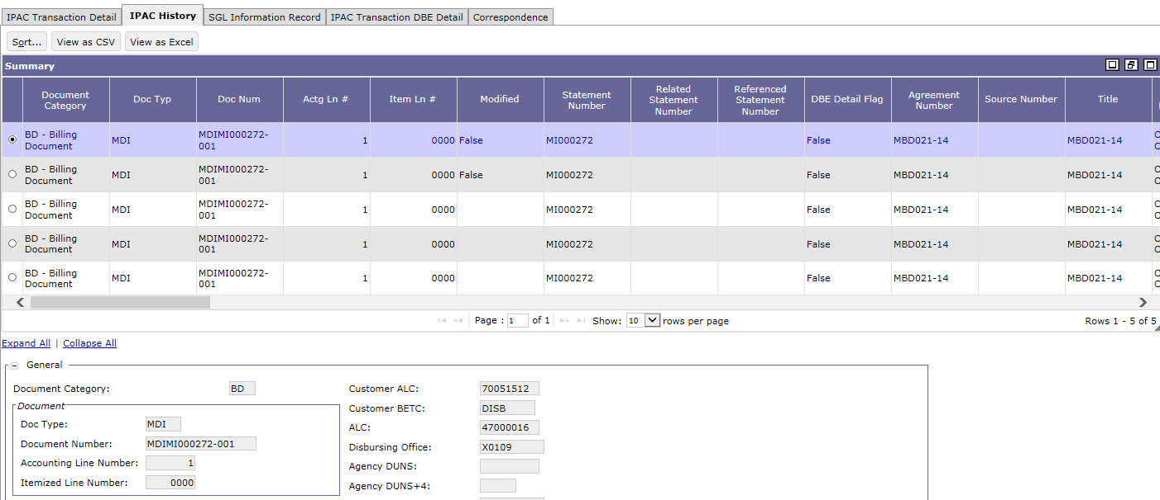
IPAC Transaction Query – IPAC Transaction Detail Billing Document
IPAC History tab displays the IPAC history of the selected record

Slide 59
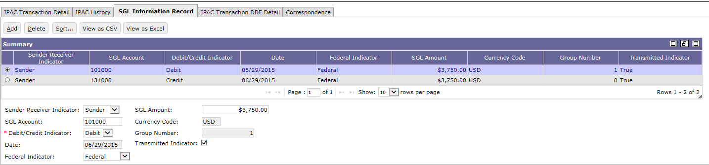
IPAC Transaction Query – SGL Information
The SGL Information tab displays the SGL information record of the transaction
Field Name | Description
Date | The date of the selected SGL information record.
Debit/Credit Indicator | Indicates whether the selected SGL Amount is a Debit or a Credit.
Federal Indicator | Indicates whether the transaction agency is federal, intra-agency, or non-federal.
Group Number | User defined value for sorting criteria within a group.
Sender Receiver Indicator | Indicates whether the selected SGL information record is of type Sender or type Receiver.
SGL Account | The Standard General Ledger Account associated with the displayed FACTS amounts.
SGL Amount | The amount of the selected SGL information record.
Transmitted Indicator | Indicates whether the selected SGL information record has been transmitted.

Slide 60
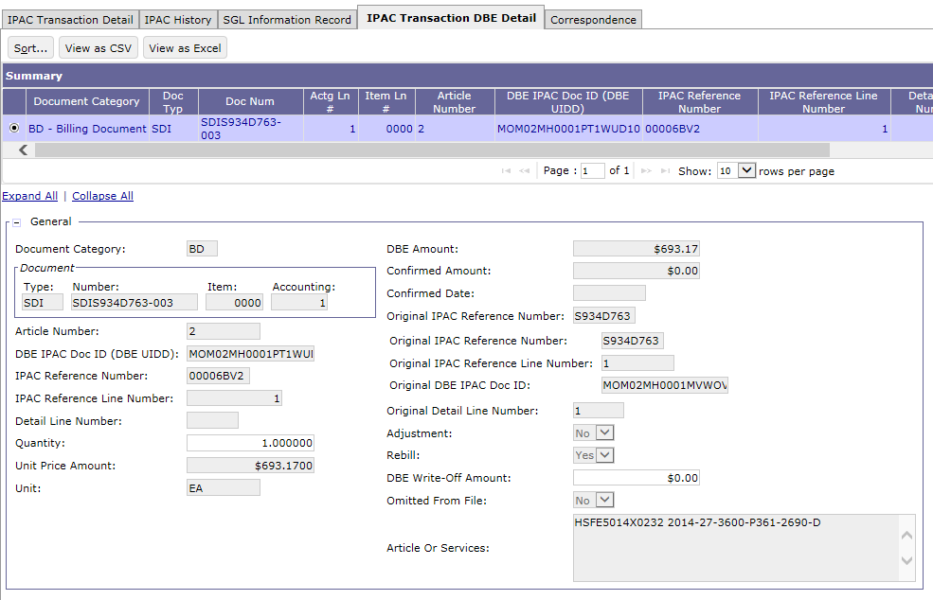
IPAC Transaction Query – IPAC Transaction DBE Detail

Slide 61
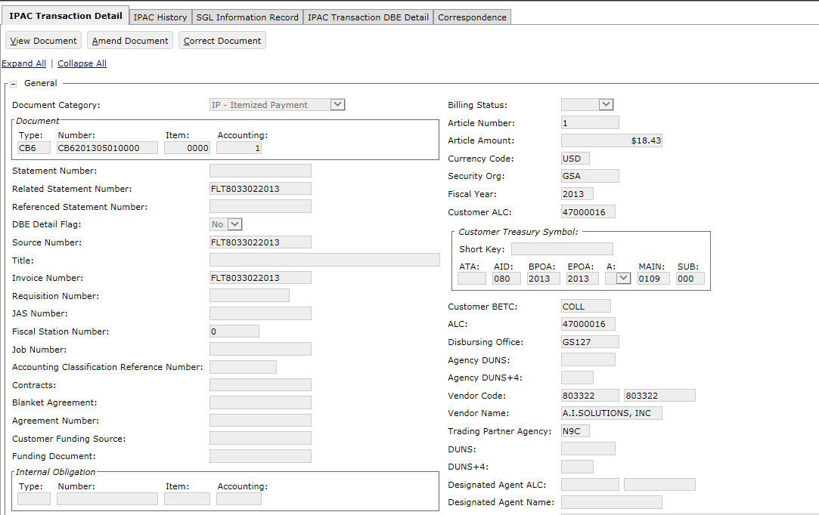
IPAC Transaction Query – IPAC Transaction Detail Itemized Payment

Slide 62
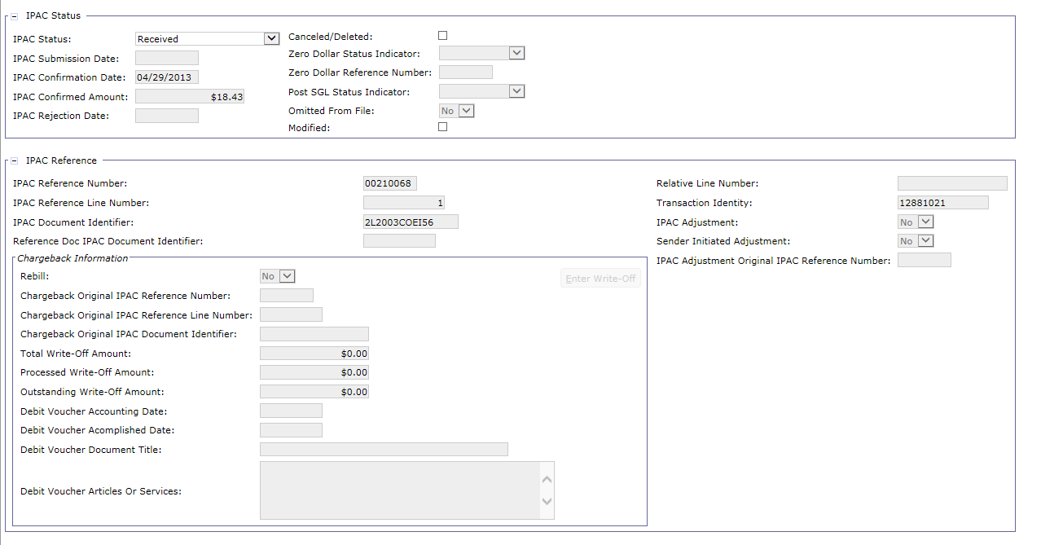
IPAC Transaction Query – IPAC Transaction Detail Itemized Payment

Slide 63
IPAC Transaction Query – IPAC Transaction Detail Itemized Payment
Field Name | Description
Related Statement Number | The Related Statement Number represents the original billing statement for which current billing (or credit) activity can be attributed.
Source Number | The specific source of the financial transaction activity.
Invoice Number | The vendor invoice number. Updated by Treasury Reconciliation, Check Posting, Direct Entry, and Manual Check transaction.
Confirmation Date | The date of confirmation by the IPAC Interface
Confirmation Amount | The transaction amount confirmed by IPAC

Slide 64
IPAC Transaction Query – IPAC Statuses:
IPAC Status | Description
Not Submitted | An IPAC Status equal to Not Submitted is given to any IPAC Bill that has been processed but not yet been sent to IPAC via IPAC Outbound.
In Transit | An IPAC Status equal to In Transit is given to any IPAC Bill that has been sent to IPAC via IPAC Outbound and awaiting confirmation via IPAC Inbound.
Rejected | An IPAC Status = Rejected is given to any IPAC Bill that has been sent to IPAC but has been rejected by IPAC. IPAC will notify the sending agency of a problem with the payment or collection via e-mail correspondence and the IPAC status will be manually set to Rejected.
Confirmed | An IPAC Status equal to Confirmed is given to any IPAC Billing Document that has been sent to IPAC via IPAC Outbound and IPAC has accepted and confirmed the transaction. Confirmation from IPAC is processed via IPAC Inbound.
Hold-Pending Chargeback | An IPAC Status of Hold-Pending Chargeback is given to an IPAC Billing Document that has an inbound collection adjustment referencing a CR which references a confirmed BD.
Do Not Send | An IPAC Status equal to Do Not Send is given to any Billing Document Article where the Rebill flag is true but the user has determined that the bill should not be resent to IPAC. The status of Do Not Send can only be set on an Article where the rebill flag is true, meaning the Article was automatically created when a Debit Voucher set to re-open the bill is processed.
Write-Off | An IPAC Status = Write-Off is given to the IPAC BD (Bill) when the write-off amount equals the total Article amount.

Slide 65
IPAC Transaction Query – IPAC Statuses: Itemized Payments
IPAC Status | Description
Not-Submitted | An IPAC Status = to Not Submitted is given to any IPAC Payment that has not yet been sent to IPAC via IPAC Outbound.
In Transit | An IPAC Status = to In Transit is given to any IPAC Payment that has been sent to IPAC via IPAC Outbound.
Rejected | An IPAC Status = Rejected is given to any IPAC Payment that has been sent to IPAC but has been rejected by IPAC. IPAC will have also notified the sending agency of a problem with the payment or collection via e-mail correspondence and the IPAC status will be manually set to Rejected.
Confirmed | An IPAC Status = Confirmed is given to any IPAC Payment that has been sent to IPAC via IPAC Outbound and IPAC has notified the sending agency of receipt.
Pending | An IPAC Status = Pending is given to any IPAC payment that does not process successfully in Pegasys during IPAC Inbound. Such IPAC transactions retain the Pending status until they process successfully. These payments are “pull payments” only.
Received | An IPAC Status = Received is given to an IPAC Payment that has been received from IPAC and successfully processes via IPAC Inbound. These payments are “pull payments” only.

Slide 66
Dunning
IPAC Treasury Rejections

Slide 67
Treasury Rejections – Steps to resolve typical GSA initiated IPAC Outbound Transaction scenarios
Error : ALC Related Note: In all cases, the vendor table should be updated to reflect changes in ALC
Solution: ALL BDs in Statement need to be changed: Note: Solution is applicable to all Region 6 Business Lines
For Normal Debit Bill:
Download the IPAC error report, manually identify rejected statements, classify the errors Statement #s included in UNIX input file for the Update IPAC Status job to read UNIX file attached to a ESC CP to be approved by GSA management GSA Config team stages file in Pegasys Infile directory GSA Ops runs Update IPAC Status job to update to Rejected Finance determines correct ALC/TAS value and CGI O&M team develops SQL to update statements/BDs (with GSA mgmt approval and subsequent implementation by the DBA team) Update Statements/BDs via SQL Run Update IPAC Status job using same input file to set the IPAC statuses to Not Submitted Re-process through IPACOUT Optional: Re-run ARBILLGEN in reprint mode and Delete original attachment using SQL
Note: Updating the IPAC Status in steps 2 through 5 above, can also be completed manually via the IPAC Transaction Query if desired.

Slide 68
Treasury Rejections – Steps to resolve typical GSA initiated IPAC Outbound Transaction scenarios
Error : ALC Related Note: In all cases, the vendor table should be updated to reflect changes in ALC
Solution: ALL BDs in Statement need to be changed: Note: Solution is applicable to all Region 6 Business Lines
For Credit Bill:
Zero-down RE6 line and process Zero-down credit BD lines (and DBRs if present) and process Generate new credit BD: Region 6 External Services - Re-run PCPROJBILL to generate new credit BD All Other Region 6 Phase 3 Business Lines – Create new DBR manually Will summarize to new statement New RE6 refund generated by Automated Credit Application batch process Execute IPACOUT via the standard process

Slide 69
Treasury Rejections – Steps to resolve typical GSA scenarios initiated IPAC Outbound Transactions
Error: Receiver TAS
Solutions
Region 6 External Services and MBL Use Article Qty/Unit Price | All Other P3 Region 6 Business Lines Use IPAC DBE Detail
ALL BDs in Statement need to be changed Update the IPAC Status to Rejected (Run Update IPAC Status job OR manually update) Update BDs online (can be done by SQL) Update the IPAC Status to Not Submitted (Run Update IPAC Status job OR manually update) Re-process through IPAC OUT | ALL BDs in Statement need to be changed Update the IPAC Status Rejected (Run Update IPAC Status job OR manually update) BDA will review the crosswalk rules to see if they need to be altered or a new one added. (Also research any open receivables with the incorrect TAS) Note: Recommendation is to update crosswalk rules outside of the billing cycle to minimize rejections and cleanup needed. Update BDs online (can be done by SQL) Update the IPAC Status to Not Submitted (Run Update IPAC Status job OR manually update) Re-process through IPAC OUT

Slide 70
Treasury Rejections – Steps to resolve typical GSA scenarios initiated IPAC Outbound Transactions
Error: Receiver BETC
Solutions:
Region 6 External Services and MBL Use Article Qty/Unit Price | All Other P3 Region 6 Business Lines Use IPAC DBE Detail
ALL BDs in Statement need to be changed Update the IPAC Status to Rejected (Run Update IPAC Status job OR manually update) Update BDs online (can be done by SQL) Update the IPAC Status to Not Submitted (Run Update IPAC Status job OR manually update) Re-process through IPAC OUT For business lines using agreements, update Customer BETC on the corresponding agreement so future BDs are created with the correct BETC. | ALL BDs in Statement need to be changed Update the IPAC Status Rejected (Run Update IPAC Status job OR manually update) BDA will review the crosswalk rules to see if they need to be altered or a new one added. (Also research any open receivables with the incorrect TAS) Note: Recommendation is to update crosswalk rules outside of the billing cycle to minimize rejections and cleanup needed. Update BDs online (can be done by SQL) Update the IPAC Status to Not Submitted (Run Update IPAC Status job OR manually update) Re-process through IPAC OUT

Slide 71
Segment 3: Update IPAC Status Batch Job

Slide 72
Table of Contents
Segment 1: Intra-Governmental Payment and Collection (IPAC) Overview
Segment 2: IPAC Billing and Outbound File Creation
Segment 3: Update IPAC Status Batch Job
Segment 4: Standard IPAC Inbound Transaction Processing
Segment 5: IPAC Chargebacks
Segment 6: Customer Generated Exceptions
Segment 7: Pulls of Non-IPAC Credits
Segment 8: IPAC Lifecycle Reports
72

Slide 73
Update IPAC Status Batch Process
The Update IPAC Status batch process (GSUPDIPAC) performs the same actions as the IPAC Transaction Query status update functionality
Updates IPAC BD transactions in bulk
Performs updates to the IPAC Status (Article level indicator)
Performs corrections to update the Billing Status (Accounting line level indicator), indicating which GL postings should occur
Specific Instances of GSUPDIPAC have been created to perform the necessary IPAC BD updates
Batch Job Id | Batch Job Name
CRBLDGSUPDIPAC | Credit Lines- Billing Status Changes to Billed
CRUNBGSUPDIPAC | Credit Lines- Billing Status Changes to Unbilled
REJGSUPDIPAC | In Transit to Rejected -IPAC Status and Billing Status
REJ2GSUPDIPAC | Rejected to Not Submitted -IPAC Status
HPCGSUPDIPAC | Hold Pending Chargeback to Not Submitted -IPAC Status
REJGSUPDIPACIP | In Transit to Rejected -IPAC Status and Billing Status for Itemized Payments
REJ2GSUPDIPACIP | Rejected to Not Submitted -IPAC Status for Itemized Payments

Slide 74
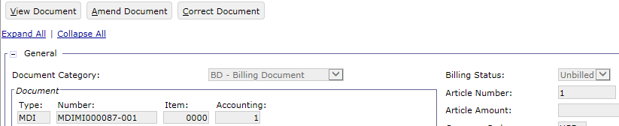
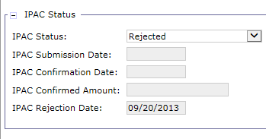
Update IPAC Status Batch Process
GSA will use the Update IPAC Status batch job to:
Update transactions to Unbilled (Billing Status)
Rejected (IPAC Status) if they are rejected by Treasury
GSA may also use this batch process for chargebacks to set a large number of transactions back to Not Submitted (IPAC Status) in order to rebill via IPAC
Run on an ad-hoc basis
Notes:
For screenshot – show the update that can occur on IPAC query

Slide 75
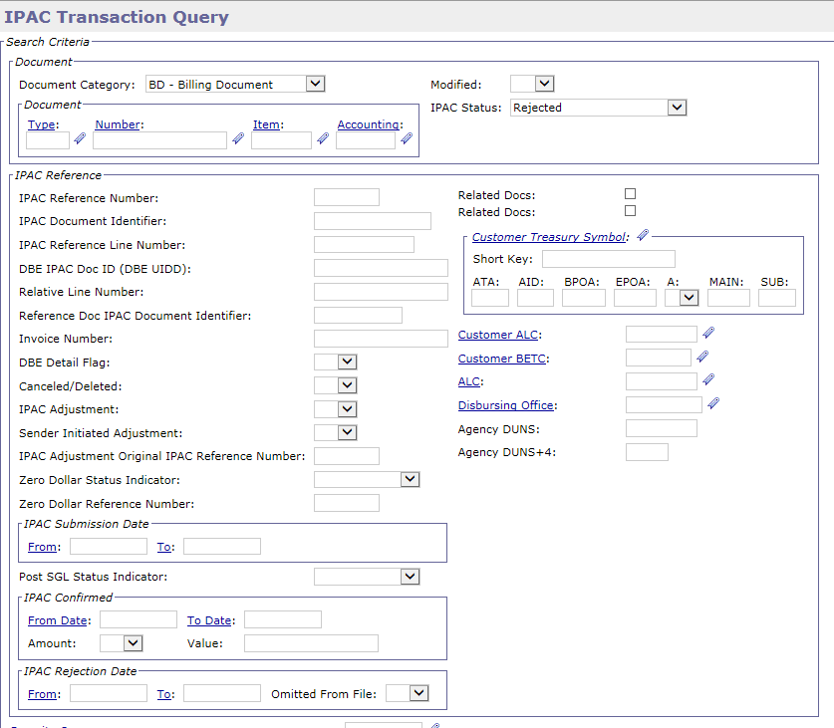
Update IPAC Status Batch Process
The following IPAC Transaction Query search parameters should be used to identify transactions that should be updated by the Update IPAC Status batch process:
Document Number IPAC Status IPAC Reference Number IPAC Rejection Date

Slide 76
Segment 4: Standard IPAC Inbound Transaction Processing

Slide 77
Table of Contents
Segment 1: Intra-Governmental Payment and Collection (IPAC) Overview
Segment 2: IPAC Billing and Outbound File Creation
Segment 3: Update IPAC Status Batch Job
Standard 4: Standard IPAC Inbound Transaction Processing
IPAC Inbound Batch Job
IPAC Bill Confirmation
IPAC Push Payments
IPAC Inbound Skips
Segment 5: IPAC Chargebacks
Segment 6: Customer Generated Exceptions
Segment 7: Pulls of Non-IPAC Credits
Segment 8: IPAC Lifecycle Reports
77

Slide 78
Dunning
IPAC Inbound Batch Job

Slide 79
IPAC Inbound Batch Job – IPAC Inbound Functionality Overview
2
3
1
Direct Connect
IPAC Outbound Job
Creates File
In Transit
Process
IPAC Bill Document
Not Submitted
4
Chargebacks
IPAC Transfers Funds
and Sends File Back
Cash Receipt Processed
Confirmed/Received
6
IPAC Inbound Job
Processes Treasury File
5

Slide 80
IPAC Inbound Batch Job: Pre-IPAC Inbound Functionality Review
Prior to the execution of the IPAC Inbound (GSIPACIN) process:
GSA runs the GSA IPAC Search Program
The IPAC Accomplishment Report is downloaded from Treasury and then processed by IPAC Search
IPAC Search creates a file that contains only the relevant BAAR information for Pegasys to process using IPAC Inbound

Slide 81
IPAC Inbound (IPACIN) Batch Job
IPAC Inbound (from Treasury)
Uploads the GSA IPAC Search file into Pegasys in order to create collections
Collections are created against IPAC and non-IPAC Bills
Creates Confirmation CR:
Confirmations of IPAC Outbound Billings:
Bill Confirmations/Collections (Cash Receipt documents)
IPAC Inbound typically used to confirm bills submitted to Treasury via IPAC Outbound bulk file
Liquidates IPAC Billing Documents
Posts General Ledger for Refund Itemized Payments
Based on IPAC Status
Updates Agreement Entity for Business Lines that reference agreements

Slide 82
IPAC Inbound (IPACIN) Batch Job
New transactions not initiated by GSA via IPAC Outbound or GOALs
Push Payments (Cash Receipt documents)
Cash Receipts that reference non-IPAC Bills or have no reference document found by the system
Pull Payments (Itemized Payment documents)
Itemized Payments that reference non-IPAC Bills or have no reference document found by the system
Adjustments of bills or refunds submitted to Treasury via IPAC
IPAC Chargebacks (Cash Receipt and Itemized Payment documents)
Bills or refunds that a customer Agency believes were sent erroneously or are incorrect

Slide 83
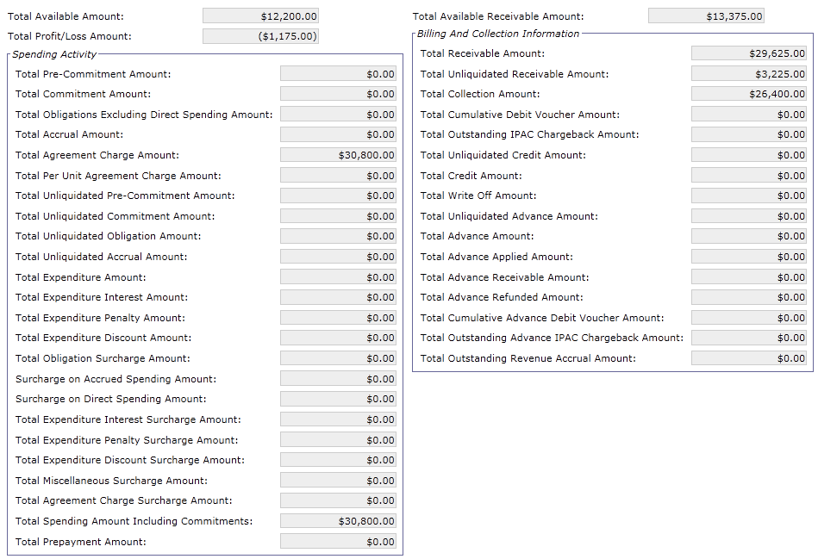
Agreement Entity – Before IPAC Inbound Normal Collection
Customer billed $3,225
Total Unliquidated Receivable Amount increased by billed amount
The next step would be to collect payment via IPAC
Notes:
Agreement created for $43,000

Slide 84
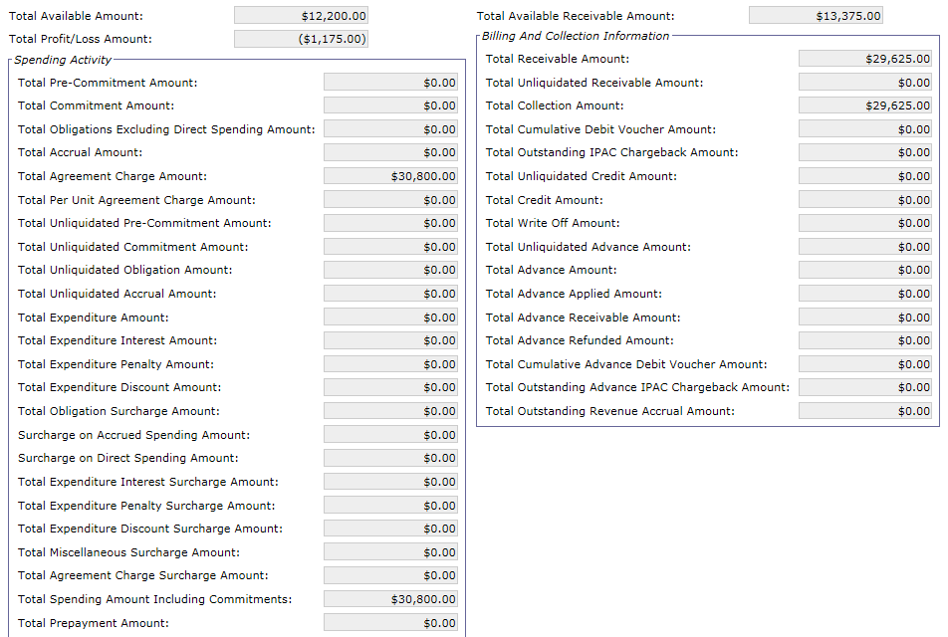
Agreement Entity – After IPAC Inbound Normal Collection
A Cash Receipt is created for $3,225:
Total Collection Amount increased by the CR
Total Unliquidated Receivable Amount decreased by the CR

Slide 85
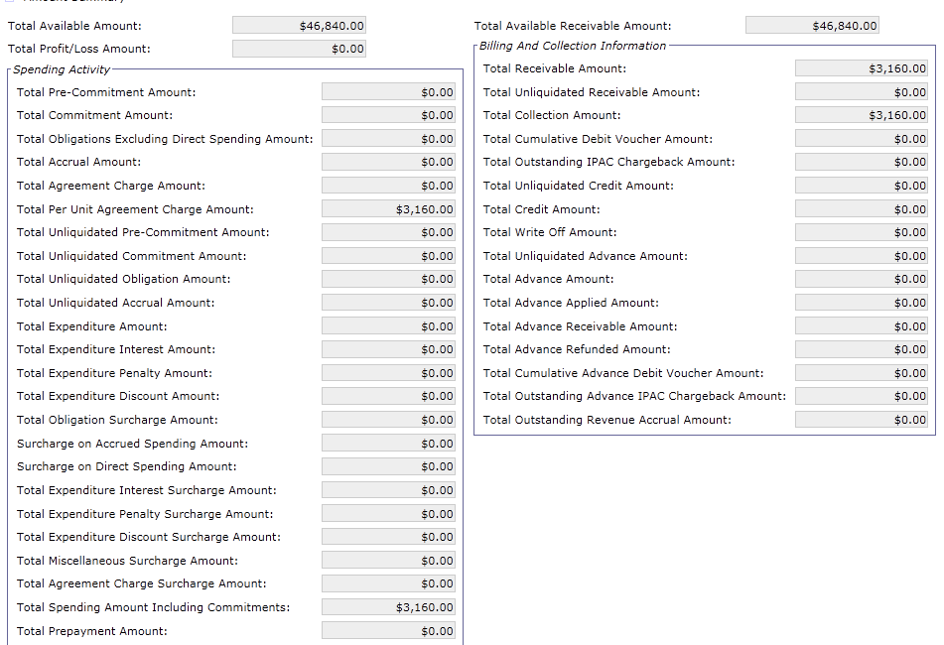
Agreement Entity – Before IPAC Inbound Chargeback
Customer billed $3,160 via IPAC
Payment confirmed via IPAC
Total Unliquidated Receivable Amount decreased by collection/billed amount
Total Collection Amount increased by collection/billed amount
Customer disagrees with collection and charges back the payment via IPAC
Notes:
Agreement created for $50,000 (Total Available Receivable + Total Receivable)

Slide 86
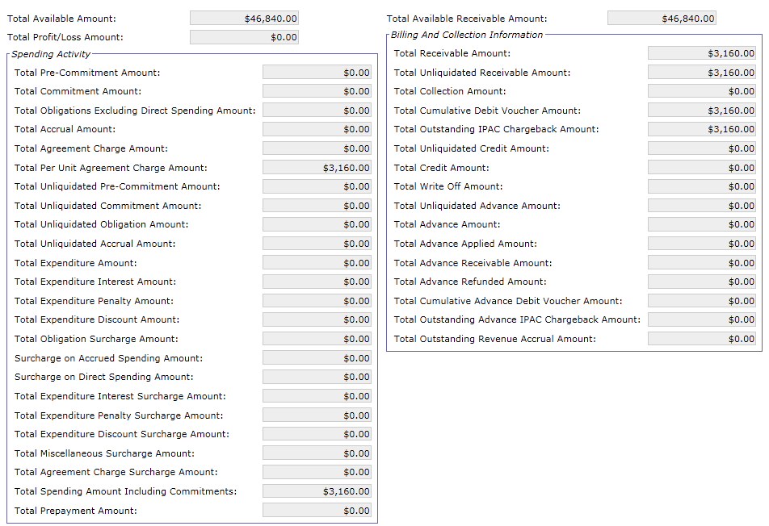
Agreement Entity – After IPAC Inbound Chargeback
Chargeback received:
Total Outstanding IPAC Chargeback Amount increased by Chargeback
Total Cumulative Debit Voucher Amount increased by Chargeback
Total Unliquidated Receivable Amount increased by Chargeback
Total Collection Amount decreased by Chargeback

Slide 87
Dunning
IPAC Bill Confirmation

Slide 88
IPAC Inbound Batch Job – IPAC Bill Confirmations
2
3
1
Direct Connect
IPAC Outbound Job
Creates File
In Transit
Process
IPAC Bill Document
Not Submitted
4
Chargebacks
IPAC Transfers Funds
and Sends File Back
Cash Receipt Processed
Confirmed/Received
6
IPAC Inbound Job
Processes Treasury File
5

Slide 89
IPAC Bill Confirmations
IPAC Confirmation Cash Receipt
Created via the IPAC Inbound batch process
IPAC Inbound uses the fields from IPAC Search file to create the Cash Receipt form
Confirms IPAC Billing Documents, posting the cash collection for the IPAC billing transaction
The IPAC Transaction Query facilitates research and reconciliation of the IPAC Cash Receipts
Detail Billing Records are not associated with IPAC Cash Receipts
Articles are associated with IPAC Cash Receipts

Slide 90
IPAC Bill Confirmations
IPAC Confirmation Cash Receipts: Detail Billing Records and Articles
Unlike IPAC Billing Documents, Detail Billing Records are not associated with IPAC Cash Receipts
Like IPAC Billing Documents, Articles are associated with IPAC Cash Receipts
The term "Article" is specific to Pegasys and is not IPAC terminology
Articles are linked to the Accounting Line
Captures information not included on the Header/Accounting Line that is specific to IPAC:
Commodity/Unit information
Quantity
Unit Price Amount
Etc.
IPAC Confirmation Cash Receipts: IPAC DBE Detail:
If the referenced Billing Document has IPAC DBE Detail records, the Cash Receipt will also have IPAC DBE Detail on the IPAC Transaction Query
If the referenced Billing Document does not have IPAC DBE Detail records, the Cash Receipt will not have IPAC DBE Detail on IPAC Transaction Query

Slide 91
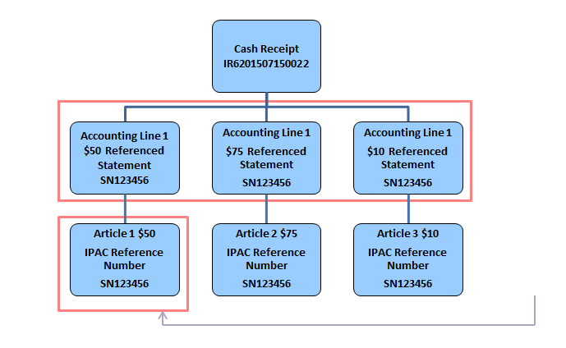
IPAC Bill Confirmations: IPAC Cash Receipt Structure - Articles and Detail Billing Records
Articles are used for IPAC only
CRs do not have Detail Billing Records

Slide 92
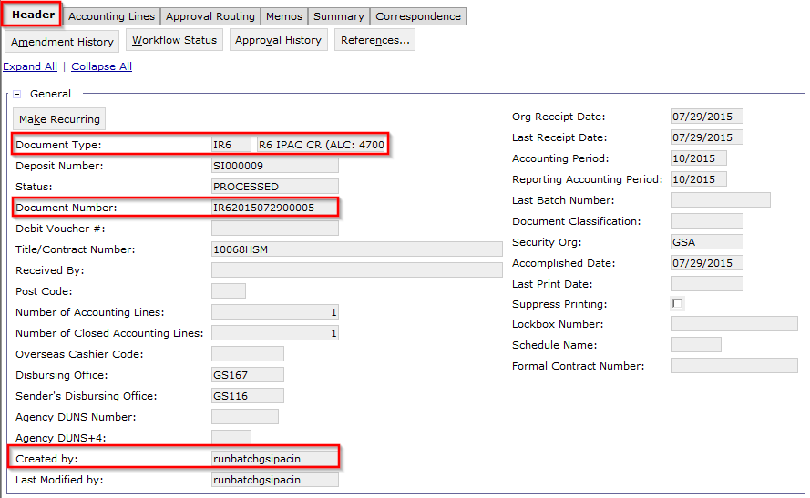
IPAC Bill Confirmations: IPAC Cash Receipt – Header

Slide 93
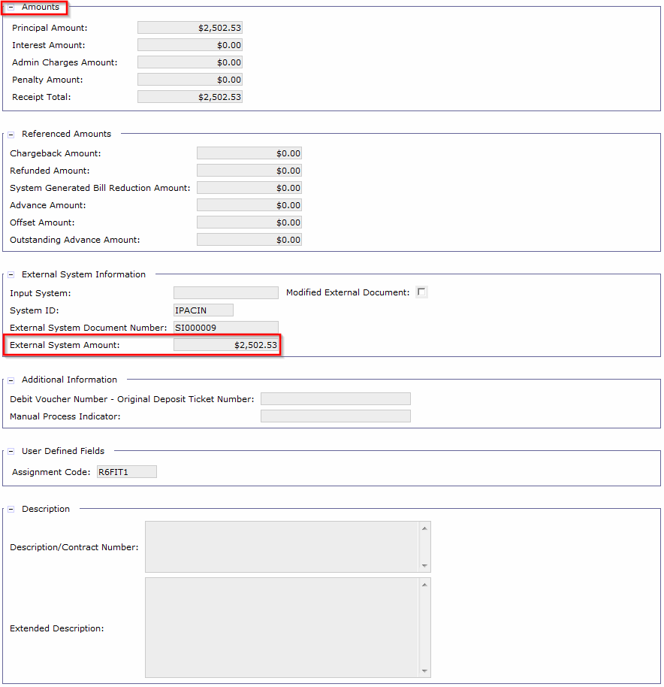
IPAC Bill Confirmations: IPAC Cash Receipt – Header (cont.)

Slide 94
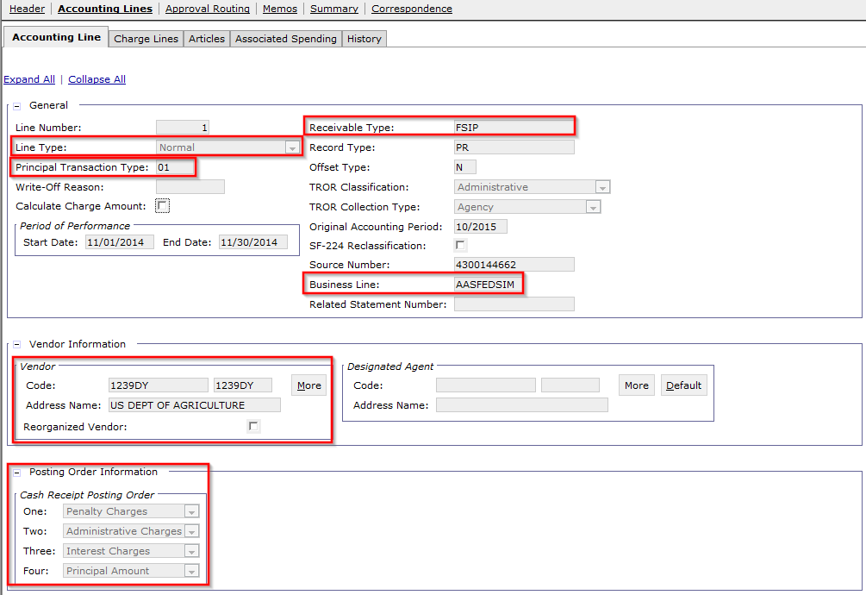
IPAC Bill Confirmations: IPAC Cash Receipt – Accounting Line

Slide 95
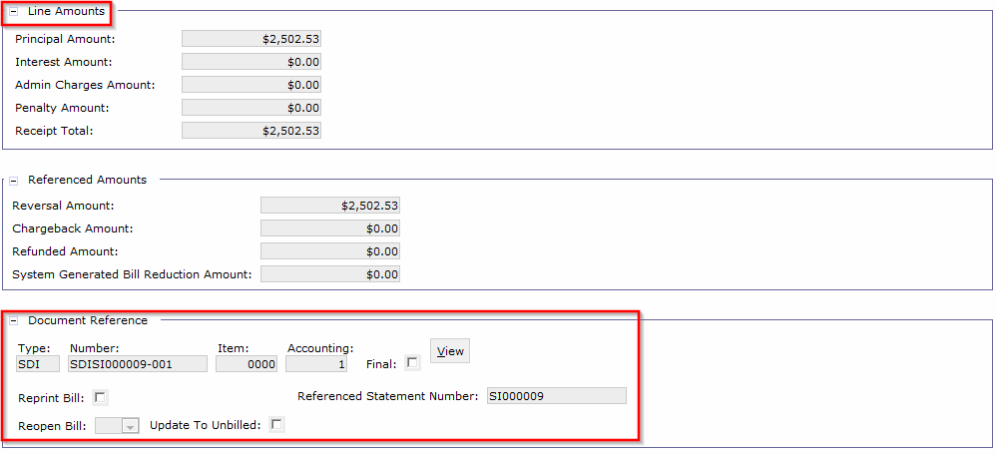
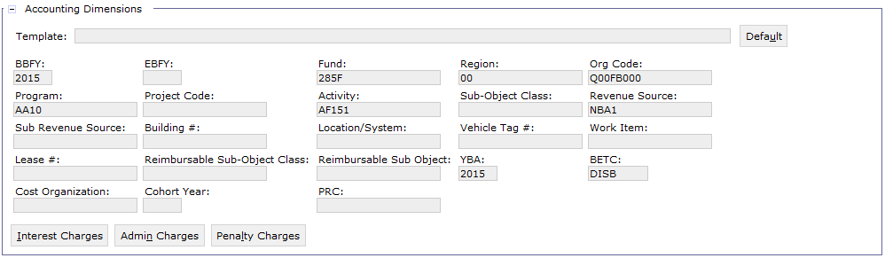
IPAC Bill Confirmations: IPAC Cash Receipt – Accounting Line (cont.)

Slide 96
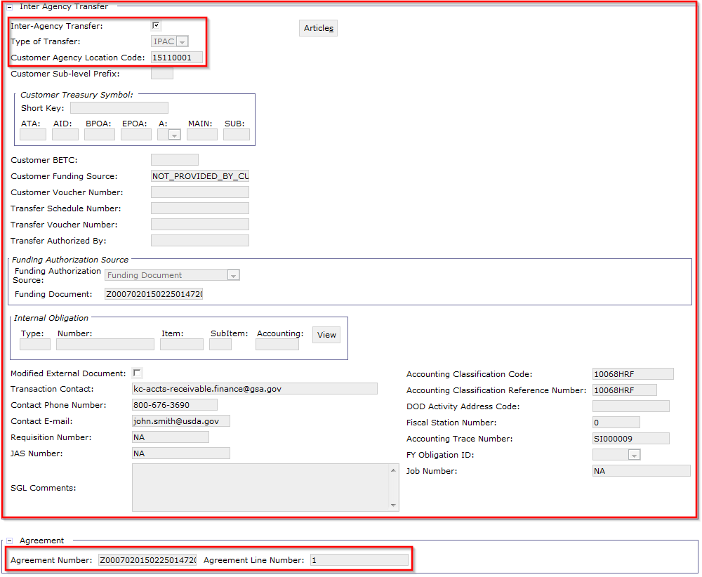
IPAC Bill Confirmations: IPAC Cash Receipt – Accounting Line (cont.)

Slide 97
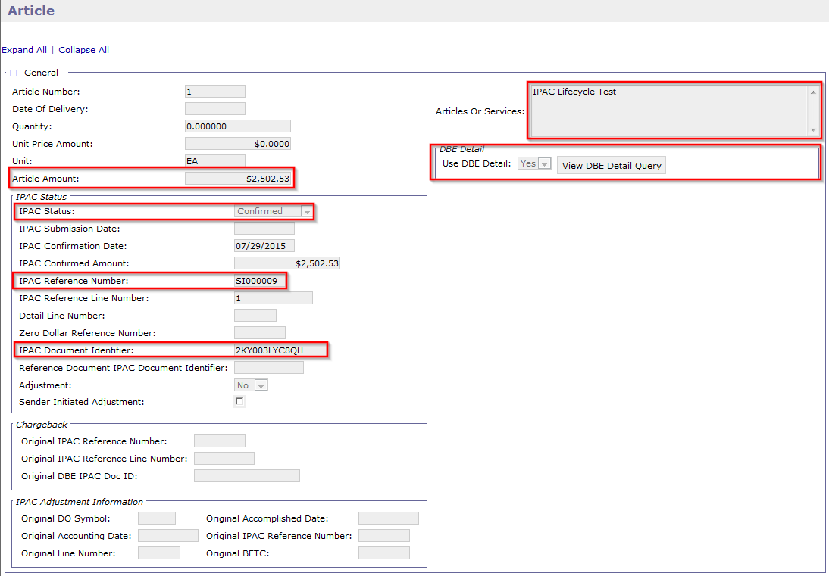
IPAC Bill Confirmations: IPAC Cash Receipt Article

Slide 98
IPAC Bill Confirmation
Updates to IPAC referenced Billing Documents
Cash Receipt liquidates/closes referenced IPAC Billing Document
Does not make any updates to the Detail Billing Records associated to the IPAC Billing Document
IPACIN process updates the IPAC Status on BD/CR Article to Confirmed

Slide 99
IPAC Transaction Query – Cash Receipt IPAC Statuses
CR IPAC Status | Description
Confirmed | An IPAC Status = Confirmed is given to any IPAC Cash Receipt Confirming an IPAC Billing Document that has been sent to IPAC via the IPAC Outbound and IPAC has notified the sending agency of receipt.
Pending | An IPAC Status = Pending is given to any IPAC collection that does not process successfully in Pegasys during the IPAC Inbound process. Such IPAC transactions retain the Pending status until they process successfully.
Received | An IPAC Status = Received is given to an IPAC Collection that is pushed from another agency (meaning the CR does not reference and confirm an IPAC BD) that has been received from IPAC and successfully processes via IPAC Inbound.
Write-Off | An IPAC Status = Write-Off is given to an IPAC Cash Receipt (CR) with a line type of Write Off. An IPAC Write -Off CR can only be generated from the IPAC Transaction Query for a referenced Bill with a write-off amount.
Notes:
Speaker Note: Some IPAC transactions may go back and forth for some time due to the nature of push and pull payments.

Slide 100
IPAC Transaction Query – Cash Receipt IPAC DBE Detail Records
Cash Receipts created by IPAC Inbound are created confirming both Billing Documents with DBE Detail as well as non-DBE Detail
Cash Receipts do not have associated Detail Billing Records
IPAC Transaction Query – If the article is set to ‘Use DBE Detail’:
IPAC Transaction DBE Detail sub-tab on the article records DBE Detail information for Cash Receipts based on the IPAC DBE Detail records associated with the original IPAC BD
Each transaction (BD, CR, any related adjustments) has their own IPAC DBE Detail records on the IPAC Transaction Query following the IPAC lifecycle

Slide 101
IPAC Transaction Query – IPAC DBE Records – IPAC Billing Statement without DBE Detail

Slide 102
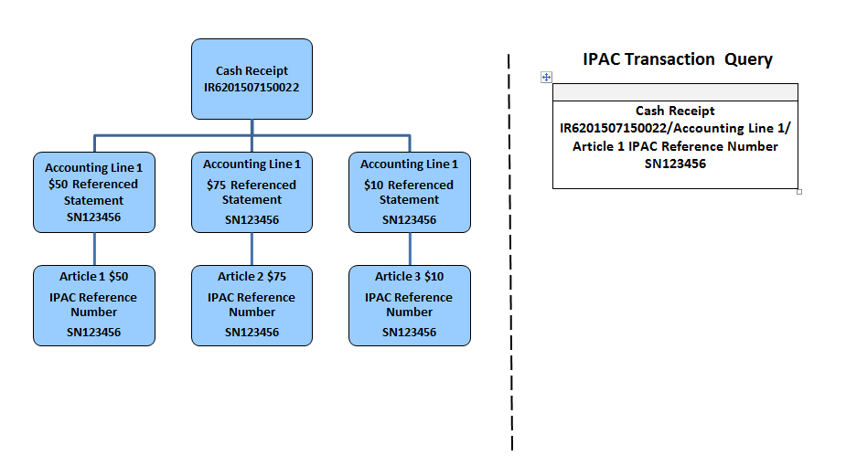
IPAC Transaction Query – Inbound Cash Receipt Information – IPAC CR without DBE Detail
Note: CRs will not have DBE Detail Records (or IPAC Children) if the referenced BD ‘s IPAC Article Qty/Unit Price Indicator is set to Use Article Qty/Unit Price

Slide 103
IPAC Transaction Query – IPAC DBE Records: IPAC Billing Statement with DBE Detail

Slide 104
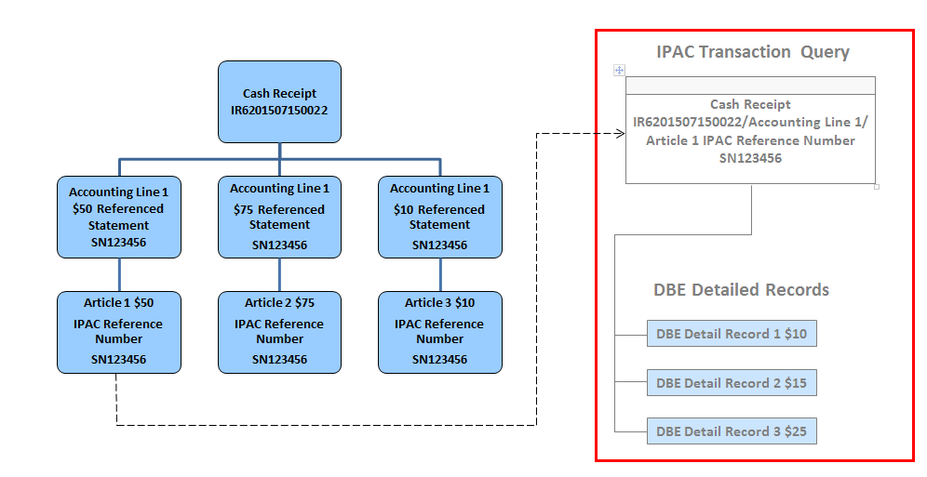
IPAC Transaction Query – Inbound Cash Receipt Information – IPAC CR with DBE Detail
CRs will have DBE Detail Records (or IPAC Children) if the referenced BD ‘s IPAC Article Qty/Unit Price Indicator is set to Use DBE Detail

Slide 105
IPAC Transaction Query
Cash Receipts created by IPAC Inbound can be viewed on the IPAC Transaction Query
IPAC Transaction Query is also used to research and review transactions sent to IPAC via IPAC Outbound process
Can be used to find Rejected Documents with IPAC Status of Pending
Can be used to find Held Documents with IPAC Status of Pending
Can be used to search by IPAC Status
Can create Correspondence from IPAC Transaction Query

Slide 106
IPAC Transaction Query – (cont.)
IPAC Transaction Query Process:
Go to IPAC Transaction Query
Search by IPAC Status to view IPAC Cash Receipts created via IPAC Inbound
Enter additional Search Criteria to narrow search results such as Document Type, Document Number, IPAC Reference Number,
Select a line and click Details
Click View Document to view IPAC CR document
Click on Accounting Lines tab
Select a line and click Accounting Line
Click Header and view References (expand tree node)
Go back to the IPAC Transaction Query
View Confirmed IPAC Status
CRs that confirm IPAC BDs will have an IPAC Status of “Confirmed”
CRs that are push payments/reference Non-IPAC BDs will have "Received" IPAC Status

Slide 107
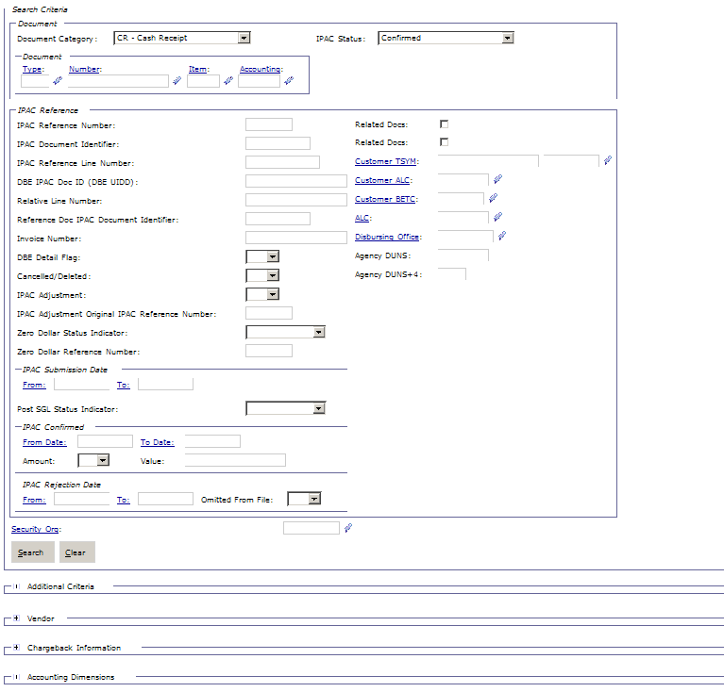
IPAC Transaction Query – (cont.)

Slide 108
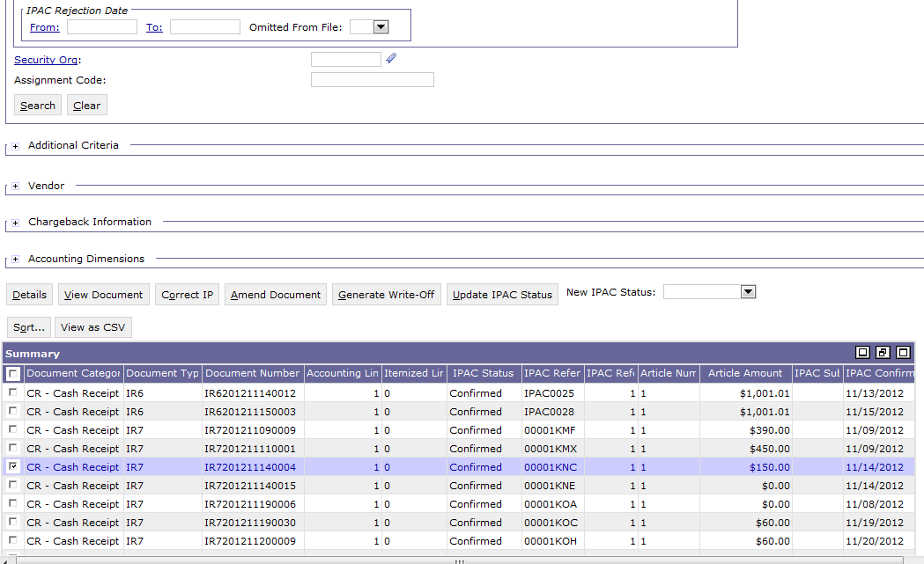
IPAC Transaction Query – CRs

Slide 109
IPAC Transaction Query – DBE Detail Process
From the IPAC Transaction Query:
Search by IPAC Status to view IPAC Cash Receipts created via IPAC Inbound job
Enter additional Search Criteria to narrow search results such as Document Category, Document Type, or IPAC Confirmed From and To Dates
Click Search and select a document in the search results
Click Details
Click IPAC Transaction DBE Detail tab
Select a Detail Line under Summary and view DBE Detail Doc ID
Click on IPAC Transaction Query
Select a line and click View Document
Click the Accounting Lines tab
Select a line and click on Accounting Line
View liquidated bill

Slide 110
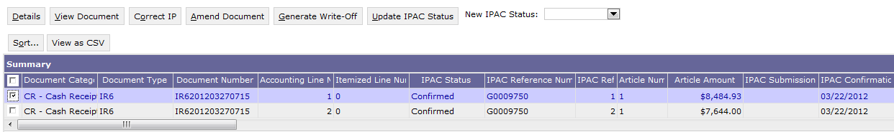
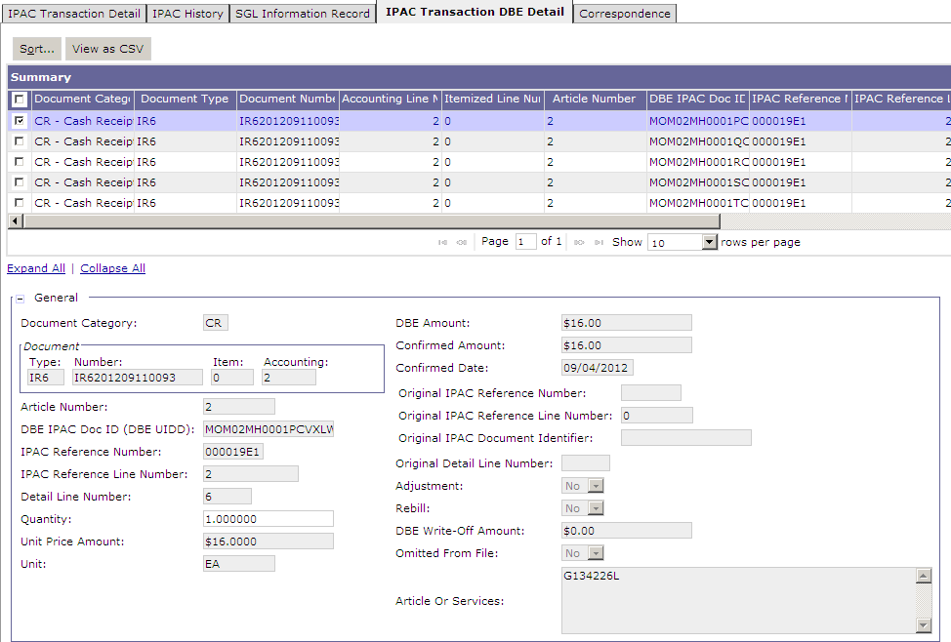
IPAC Transaction Query – CRs
Search results for IPAC CRs
IPAC Transaction DBE Detail
DBE IPAC ID

Slide 111
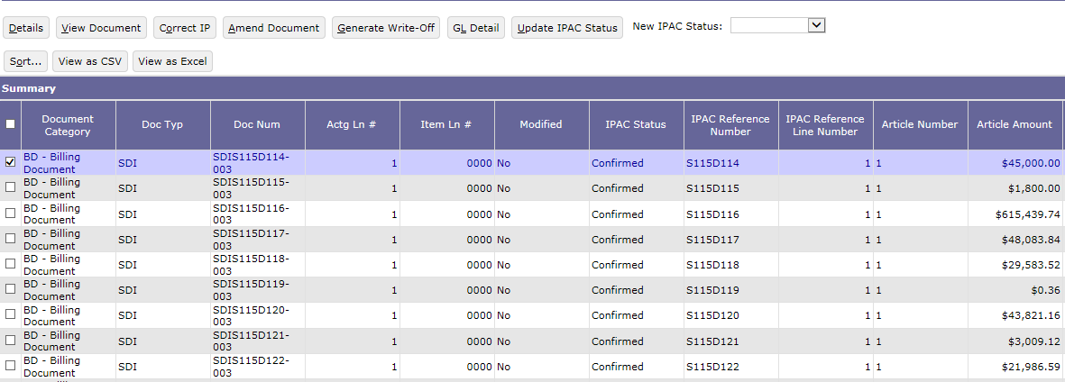
IPAC Transaction Query – BD Updates from Inbound
Search results for IPAC BDs

Slide 112
Dunning
IPAC Push Payments

Slide 113
IPAC Push Payments
IPAC Push Payments Overview:
An IPAC Push Payment is a payment a customer agency sends (or “pushes”) to GSA via Treasury’s IPAC system
Push Payments may be billed by GSA outside of Treasury’s IPAC system
GSA posts customer agency non-IPAC bill on VCSS
Customer agency sends GSA a payment via IPAC
GSA provides “Pay By IPAC” information for Non-IPAC Statements to encourage IPAC payments
Agencies do not need a Trading Partner Agreement to push money via IPAC
Customer Agency sends GSA a payment via IPAC utilizing the GOALs system
Pegasys uses the information included in GOALS by the customer to find the Non-IPAC Statement/Billing Document to apply the collection

Slide 114
IPAC Push Payments – (cont.)
IPAC Inbound Processing of Push Payments:
Pegasys accepts the transaction by creating a Cash Receipt document
Pegasys attempts to find a reference document using the information included in the accomplishment report
Three Push Payment Scenarios:
Billing Document reference found: IPAC Collection Amount = or < BD Amount
Billing Document reference found: IPAC Collection Amount > BD Amount
Billing Document reference not found

Slide 115
IPAC Push Payments – (cont.)
IPAC Inbound Processing of Push Payments:
Billing Document Reference Found, Scenario 1 –
IPAC Collection Amount = or < Billing Document Amount:
If the reference Billing Document is found and the IPAC collection is for the same amount or less than the Billing Document:
Region 6 – IPAC Cash Receipt processes
Note: If the Collection Amount is less than the Billing Document Amount (i.e., only a partial collection was made), an outstanding balance for the difference will remain on the BD

Slide 116
IPAC Push Payments – (cont.)
IPAC Inbound Processing of Push Payments:
Billing Document Reference Found, Scenario 2 –
IPAC Collection Amount > Billing Document Amount:
If the reference Billing Document is found and the IPAC collection amount is greater than the Billing Document:
Region 6 – IPAC Cash Receipt rejects, creating an overpayment line that must be corrected

Slide 117
IPAC Push Payments – (cont.)
IPAC Inbound Processing of Push Payments:
Billing Document Reference Not Found, Scenario 3 –
Billing Document Reference Not Found:
If a reference Billing Document cannot be found, the Cash Receipt is created and saved as a Held form

Slide 118
Related GSA IPAC Report Rejected/Held IR6s and DR6s
Rejected/Held IR6s and DR6s – Daily report generated by GSA that helps find and identify details so forms can be corrected
Document Number | DOC Status | DOC Date | Accmpl Date | Deposit No | Description | Total Prnc Amt | Trans Amt
IR6201503191169 | HELD | 3/31/2015 | 3/18/2015 | 109A0FMH | REBILL GSA BILL-S235D651 |  | 34.5
IR6201507200361 | REJECTED | 7/31/2015 | 7/9/2015 | 69306227 | Please resend this payment to ALC 10025697 we are no longer receiving payments to ALC 5697 | 300 | 300
NOTE: Send an email to Trung Truong or Bonita Jones to receive daily emails containing these reports.

Slide 119
IPAC Push Payments – (cont.)
Successfully Processed Push Payments - IPAC/Document Statuses:
Create/Process Collection Transactions
Cash Receipts (CRs) represent collection of cash
Update Referenced Documents
Push Payment CRs liquidate/close non-IPAC BDs
IPAC Status - Article level indicator
Many different values that correspond to the IPAC lifecycle in Pegasys
Set to “Received” by IPAC Inbound on new Push Payment CRs

Slide 120
IPAC Push Payments
GSA occasionally receives transactions from Treasury's IPAC system with incorrect or missing information, requiring changes to be made on Push Payment documents
External System Amount field on the CR
Tracks the amount of the transaction as originally recorded on the IPAC File
Also tracks the document amount for multiple documents or documents split by the inbound process,
For example, if a multiple document statement is paid via IPAC, each CR will have an External System Amount that equals the Total Amount of all Accounting Lines on the document originally created by the IPAC process, the total IPAC file amount
Modified External Document flag
Is set if the user changes the dollar amount on Accounting Lines and it is now different than the transaction amount received via IPAC
Pegasys compares the form or document's amount to the corresponding IPAC Transaction record
If the corrected amount on the form/document is greater than the External System Amount, users will receive a hard error
If corrected amount on the form/document is less than the External System Amount, users will receive an overrideable error.

Slide 121
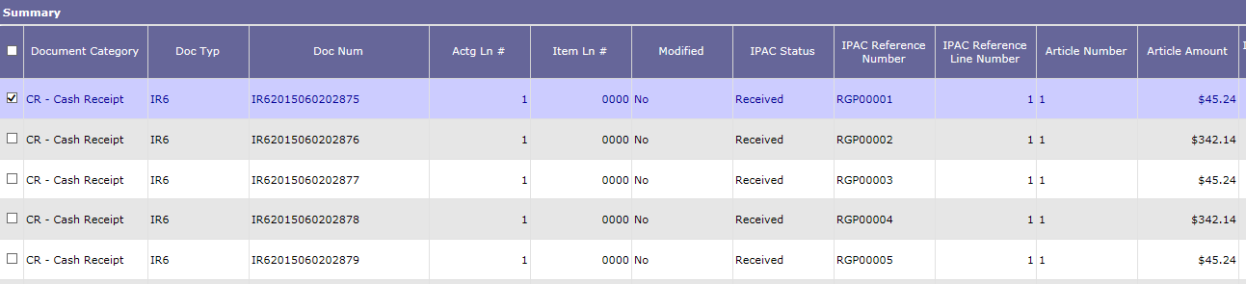
IPAC Push Payments – IPAC Transaction Query – CR Push Payment
Go to IPAC Transaction Query
Search for IPAC Cash Receipts with an IPAC status of Received
Select a record from the Item Collection
Note: The IPAC Transaction Query does not display Non-IPAC Billing Documents liquidated by the CR Push Payment

Slide 122
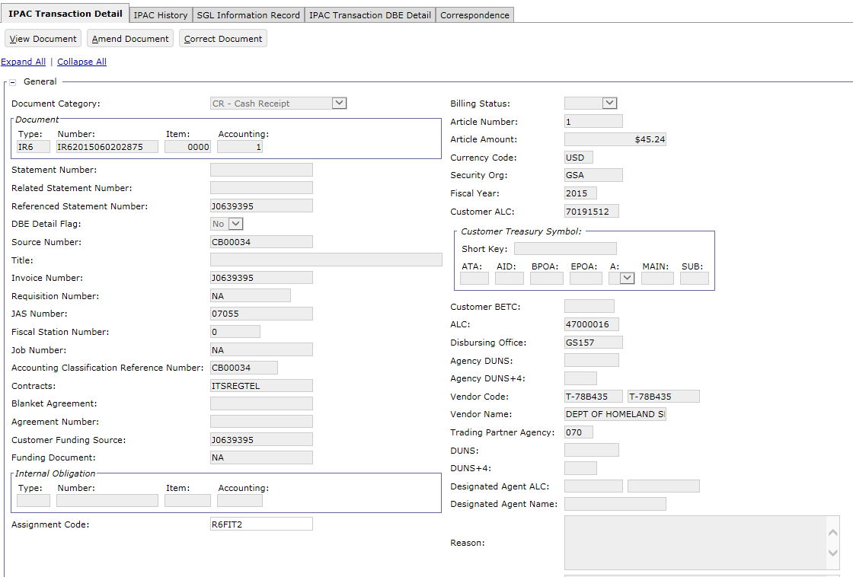
IPAC Push Payments – IPAC Transaction Query- Detail
Select Details and view the IPAC Transaction Detail

Slide 123

IPAC Push Payments – IPAC Transaction Query - Detail

Slide 124
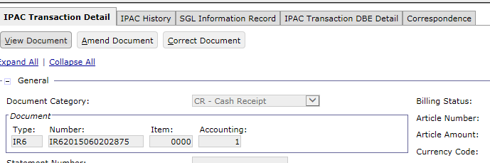
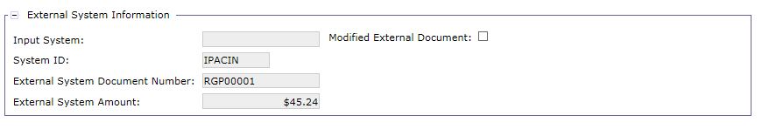
IPAC Push Payments – IPAC Transaction Query - Detail
From the IPAC Transaction Detail, select View Document
View the External System Amount and the Modified External Document flag on the CR header

Slide 125
IPAC Push Payments – Overpayments
IPAC Inbound Processing of Overpayment Push Payments:
When an IPAC push payment is received greater than the reference BD:
IPAC Inbound attempts to find a reference document using the information included in the accomplishment report
If the reference Billing Document is found and the IPAC collection amount is greater than the Billing Document:
Region 6 – IPAC Cash Receipt rejects, creating an overpayment line that must be corrected

Slide 126
IPAC Push Payments – Overpayments (cont)
IPAC Inbound Processing of Overpayment Push Payments:
To process the Held/Rejected overpayment document
If another BD document can be found to apply the overpayment to:
Update the trans type to 01 on the overpayment line
Populate the appropriate BD document reference on the overpayment line
Populate the accounting dimensions with the dimensions from the second BD on the overpayment line
If another BD cannot be found to apply the overpayment to, users have 2 options
Option 1: Process as an unapplied collection
If GSA cannot identify a PCAS agreement for which the payment can be applied
Option 2: Process as an advance
If GSA can identify a PCAS agreement for the same customer (with no outstanding BDs)

Slide 127
IPAC Push Payments – Overpayments (cont)
IPAC Inbound Processing of Overpayment Push Payments
If another BD cannot be found to apply the overpayment to (con’t):
Option 1: Process overpayment line as an unapplied collection if GSA cannot identify a related PCAS agreement
Confirm the Transaction Type is set to 02 on the overpayment line
Records the overpayment amount as an unapplied collection (299000.08 liability) in General Ledger
Remove the BD document reference on the overpayment line
Originally populated by IPACIN, but should be removed to process as unapplied
Update the Accounting Dimensions section on the overpayment line:
Originally populated by IPACIN with dimensions from the referenced BD on line 1
Replace the Accounting Template/Dimensions with the generic Region 6 unapplied collection Accounting Template/Dimensions
Select Default button to default dimensions
Remove the agreement reference on the overpayment line (for business lines using PCAS agreements only)

Slide 128
IPAC Push Payments – Overpayments (cont)
IPAC Inbound Processing of Overpayment Push Payments (con’t)
Option 2: Process overpayment line as an advance if GSA can identify a PCAS agreement for the same customer (with no outstanding BDs)
Update the Transaction Type from 02 to 04 on the overpayment line
Records the overpayment amount as an advance (231000.06 liability) in General Ledger
Remove the BD document reference on the overpayment line
Originally populated by IPACIN, but should be removed to process as advance
Update the Accounting Dimensions section on over payment line
Originally populated by IPACIN with dimensions from the referenced BD on line 1
Update to record Accounting Template/dimensions from newly referenced agreement

Slide 129
IPAC Push Payments – Overpayments (cont)
IPAC Inbound Processing of Overpayment Push Payments (con’t)
Option 2 (con’t): Process overpayment line as an advance if GSA can identify a PCAS agreement for the same customer (with no outstanding BDs)
Agreement Reference section:
If referenced BD on line 1 is associated with PCAS agreement, leave Agreement Reference as is
If referenced BD on line 1 is not associated with PCAS agreement but an agreement can be found for same customer:
Update the Agreement Reference section to record the related Agreement Number and Line Number on overpayment line
Referenced agreement will show new Unliquidated Advance amount after processing

Slide 130
Dunning
IPAC Inbound Skips

Slide 131
IPAC Inbound Skips
Reasons why IPACIN may skip some records during processing:
Legacy chargebacks
Payment or collection references a bill generated in the Legacy system that was not converted in Pegasys as part of the BAAR implementation
Occur within the first 90 das after go-live
AAS Business Lines using the PCAS/DBR hybrid model
Will not have skipped transactions due to Legacy chargebacks
AAS Legacy chargebacks will follow the normal chargeback processes discussed in the IPAC Chargeback Overview section of this training course
Note: AAS Business Lines using the PCAS/DBR hybrid model include: AASFedSim, AASREGIT, IWAC, ITSEXPSER, ITSNATITCM, ITSHSPD12

Slide 132
IPAC Inbound Skips (cont.)
Reasons why IPACIN may skip some records during processing (cont.):
Multi-tenancy
When one GSA Agency Location Code tries to IPAC another GSA Agency Location Code and they have the same Transaction ID
Error is caused when one organization within GSA is trying to IPAC another organization instead of doing an Internal Voucher (e.g., AAS and Telecom IPACing each other)
IPAC Inbound skip resolution
Contact GSA Production Support for assistance in resolving IPAC Inbound skip issues

Slide 133
Table of Contents
Segment 1: Intra-Governmental Payment and Collection (IPAC) Overview
Segment 2: IPAC Billing and Outbound File Creation
Segment 3: Update IPAC Status Batch Job
Segment 4: Standard IPAC Inbound Transaction Processing
Segment 5: IPAC Chargebacks
IPAC Chargebacks Overview
Collection Adjustments
Payment Adjustments
Segment 6: Customer Generated Exceptions
Segment 7: Pulls of Non-IPAC Credits
Segment 8: IPAC Lifecycle Reports

Slide 134
Dunning
IPAC Chargebacks
Overview

Slide 135
IPAC Chargebacks
Chargebacks as defined by Treasury (“Adjustments”):
If a customer agency disagrees with an IPAC transaction sent from GSA, they “charge back” the transaction
Treasury calls chargebacks “Adjustments”:
An Adjustment is a transaction the customer agency initiates to adjust an erroneous or incorrect payment or collection
Customer agencies can only use adjustments to reduce (adjust down) the original transaction amount
Treasury 90 Day Window – Agencies have to process an adjustment against a payment or collection within 90 days of the original transaction’s accomplished date

Slide 136
IPAC Chargebacks
Types of chargebacks (collection versus payment adjustments):
Collection Adjustment – GSA receives an adjustment from a customer on a bill GSA sent to the customer
GSA's customer charges back the billing sent by GSA - Customer “takes” money back from GSA
Payment Adjustment – GSA receives an adjustment from a customer on a payment GSA sent to the customer
GSA sends a credit to the customer that the customer decides to send back to GSA

Slide 137
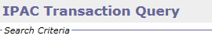
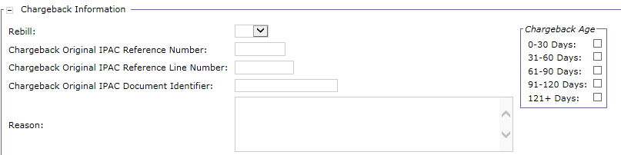
IPAC Chargebacks
The IPAC Transaction Query is used to reconcile and track chargebacks
Billing Document records on the IPAC Transaction Query with an IPAC Status of "Hold Pending Chargeback" are identified as chargebacks
BD lines that have been charged back are aged on the IPAC Transaction Query
Search options include Rebill Flag, Age and Reason
Chargebacks can be corrected and a chargeback reason can be entered
Correspondence to the customer can be added during the chargeback research period

Slide 138
Related GSA IPAC Report Chargebacks
Chargebacks – Daily report generated by GSA that helps find and identify details so these forms can be corrected
Document Number | DOC Status | DOC DATE | Accmpl Date | Description | Trans Amt | Payee ALC
CB6201508140004 | HELD | 8/31/2015 | 8/12/2015 | REVERSAL OF 1903695108 DUP PYMT 1903763521 | 632.75 | 8522
CB6201508130000 | HELD | 8/31/2015 | 8/5/2015 | GSA CORRECT DOV 31681 WRONG INV NUM S/B PN001011 | 371175 | 6102
NOTE: Send an email to Trung Truong or Bonita Jones to receive daily emails containing these reports.

Slide 139
IPAC Chargebacks – Chargeback Reason Codes
The following are pre-defined reason codes for chargebacks; users can enter other reasons, as appropriate.
Reason Codes | Description | Responsible
CANCELED | The project was cancelled | FSC
CANNOTID | Can not identify the charge or unable to recognize the line of accounting ; however, since the bills are on the web, chargebacks with this reason code are generally rejected | Finance
CONTCLSD | The service period for the contract has ended | FSC
CONTOVER | The charges exceed the amount authorized by your funding document | FSC
EOMREJ | Agency billed after cut-off (w/in last 3/5 bus days of the month | Finance
FUNDSEXP | Funds are no longer available on the funding document that has been billed | FSC
INVALIDX | The charges are not valid for whatever reason | FSC
MIPRCLSD | The service period for this MIPR has ended | FSC
MIPROVER | The charges exceed the amount authorized by your MIPR funding document | FSC
NOFSN | Customer is not able to find the FSN in the line of accounting (LOA) | Finance
NOLOA | Billing document does not show the necessary line of accounting | FSC
NONIPAC | Charges should not have been billed through IPAC | Finance
NORECEIP | For non receipt of goods/services | FSC
NOSVCMTH | Period of service not included on billing (GSA-P Billings) | FSC
PAYMENT | Customer paid on IPAC invoice (collection would be recorded and process a refund since the agency paid for an IPAC bill already collected) | Finance
RENT | Rent chargebacks | Finance
WRNGAGCY | The wrong agency was billed | FSC
WRONGALC | The wrong ALC within an agency was billed | Finance
WRONGLOA | The wrong line of accounting was used on the bill | Finance
WRONGTAS | The wrong Treasury Account Symbol was used on the bill | Finance
Notes:
Speaker Note: FSN refers to “Fiscal Station Number”. FSC refers to “Facilities Support Center”.

Slide 140
IPAC Chargebacks – Chargeback related IPAC statuses
Billing Document | IPAC Status = Not Submitted | An IPAC Status = Not Submitted is given to any IPAC Payment or Bill that has not yet been sent to IPAC via IPAC Outbound.
Billing Document Itemized Payment | IPAC Status = Rejected | An IPAC Status = Rejected is given to any IPAC Payment or Bill that has been sent to IPAC but has been rejected by IPAC. IPAC will have also notified the sending agency of a problem with the payment or collection via e-mail correspondence and the IPAC status will be manually set to Rejected.
Billing Document Itemized Payment | IPAC Status = In Transit | An IPAC Status = In Transit is given to any IPAC Payment or Bill that has been sent to IPAC via IPAC Outbound.
Billing Document Cash Receipt Itemized Payment | IPAC Status = Confirmed | An IPAC Status = Confirmed is given to any IPAC Payment, Billing Document that has been sent to IPAC via IPAC Outbound and IPAC has notified the sending agency of receipt. The IPAC Status = Confirmed is also given to any IPAC Cash Receipt confirming an IPAC Billing Document.
Billing Document | IPAC Status = Hold Pending Chargeback | An IPAC Status = to Hold Pending Chargeback is given to an IPAC Billing Document where an inbound collection adjustment is created referencing a CR that references a BD with an IPAC status of Confirmed.
Billing Document | IPAC Status = Do Not Send | An IPAC Status = to Do Not Send is given to any Billing Document Article where the Rebill flag is true but the user has determined that the bill should not be resent to IPAC. The status of Do Not Send can only be set on an Article where the Rebill flag is true, meaning the Article was automatically created when a Debit Voucher set to re-open the bill is processed.
Billing Document Cash Receipt | IPAC Status = Write-Off | An IPAC Status = Write-Off is given to the IPAC BD (Bill) when the write-off amount = the total Article amount. An IPAC Status = Write-Off is given to an IPAC Cash Receipt (CR) with a line type of Write Off. An IPAC Write -Off CR can only be generated from the IPAC Transaction Query for a referenced Bill with a write-off amount.
Cash Receipt Itemized Payment | IPAC Status = Pending | An IPAC Status = Pending is given to any new IPAC payment or collection that does not process successfully in Pegasys during IPAC Inbound. Such IPAC transactions retain the Pending status until they process successfully. An IPAC Status = Pending is given to any IPAC Payment that does not process successfully in Pegasys during IPAC Inbound. Such IPAC transactions retain the Pending status until they process successfully. These payments are “pull payments” only.
Cash Receipt Itemized Payment | IPAC Status = Received | An IPAC Status = Received is given to an new IPAC Collection or Payment (pull payments only) that has been received from IPAC and successfully processes via IPAC Inbound.

Slide 141
Typical IPAC Chargeback Scenario
GSA provides goods/services to Customer Agency
GSA bills Customer Agency for the goods/services via IPAC
Pegasys: Bill Generation and IPAC Outbound
Customer Agency disagrees with the billed amount
Customer Agency charges back (i.e., adjusts) the transaction via IPAC
Treasury GOALS system is used to perform the adjustment
GSA is notified of chargeback from Customer Agency via Pegasys IPACIN process
GSA determines whether the chargeback is valid or if the original bill should be rebilled

Slide 142
Dunning
Collection Adjustments

Slide 143

IPAC Chargebacks – Collection Adjustments
A Collection Adjustment is created by a customer when they do not agree with the IPAC bill received from GSA
Customer creates a “Billing Adjustment” in IPAC
GSA receives a “Collection Adjustment” from IPAC
Collection Adjustments are received in the Treasury IPAC Accomplishment Report and processed in Pegasys using IPAC Inbound
Pegasys creates the Collection Adjustment as a Cash Receipt transaction with a Debit Voucher line type
A negative line type that records the Chargeback and reopens the associated bill
Collection Adjustments can be: Rebilled, Accepted, Written-Off

Slide 144
IPAC Chargebacks – Collection Adjustments
GSA bills Customer Agency for $500 via IPAC
A Collection is received via IPAC for the full Amount $500
The Customer Agency then feels that the full $500 bill was erroneous
The Customer Agency initiates a Chargeback through IPAC
GSA receives this Collection Adjustment as a Cash Receipt Debit Voucher
The Debit Voucher line type references the original collection (Cash Receipt document)
The Debit Voucher line type reopens the original Billing Document

Slide 145
IPAC Chargebacks – Collection Adjustments
Receives this Collection Adjustment as a CR debit voucher
The Debit Voucher line type references the original Cash Receipt
The Debit Voucher line type reopens the original Billing Document
Views Cash Receipt with Debit Voucher line type
"Amounts" (negative amount for IPAC DV chargeback) on Header
References original Cash Receipt on Accounting Line
"Amounts" (negative amount for IPAC DV chargeback) and Debit Voucher "Line Type" on Accounting Line tab
"IPAC Adjustment Information" on Articles tab
View Original Bill
"Chargeback Amounts" on Header & Accounting Line tabs
"IPAC Status" and "Chargeback" sections on Articles tab
If Collection Adjustment includes DBE Detail, View DBE detail from the IPAC Transaction record

Slide 146

IPAC Chargebacks – Collection Adjustments: Cash Receipt Debit Voucher Overview
Example: IPAC CR Debit Voucher - Header

Slide 147

IPAC Chargebacks – Collection Adjustments: Cash Receipt Debit Voucher Overview
Example: IPAC CR Debit Voucher – Accounting Line

Slide 148

IPAC Chargebacks – Collection Adjustments: Cash Receipt Debit Voucher Overview
Example: IPAC CR Debit Voucher Article

Slide 149

IPAC Chargebacks – Collection Adjustments: Cash Receipt Debit Voucher Overview
Example: Updates to BD – Header

Slide 150


IPAC Chargebacks – Collection Adjustments: Cash Receipt Debit Voucher Overview
Example: Updates to PCAS Agreement (via Agreement Query)

Slide 151
IPAC Chargebacks – Collection Adjustments
IPAC Inbound Processing: Cash Receipt Debit Voucher
Reference Document Updates
Creates/Processes Collection Adjustment Transactions
Cash Receipts/Debit Vouchers (CR/DVs) represent reduction of cash
Updates Referenced Documents
CR/DVs reduce IPAC BD collected amount, increase chargeback amount
The CR/DV is the Treasury adjustment transaction or the chargeback
Creates a “Rebill Article” on the associated BD
Updates IPAC Status – Article level indicator
CR/DV Article set to “Received” on CR/DV by IPAC Inbound
Rebill Article set to “Hold Pending Chargeback” on BDs by IPAC Inbound

Slide 152

IPAC Chargebacks – Collection Adjustments: Cash Receipt Debit Voucher Overview
Example: Updates to BD – Accounting Line

Slide 153

IPAC Chargebacks – Collection Adjustments Cash Receipt Debit Voucher Overview
Example: IPAC BD Rebill Article – Item Collection

Slide 154
IPAC Chargebacks – Collection Adjustments
Collection Adjustment Resolutions
GSA receives Collection Adjustment
GSA researches Collection Adjustment
IPAC Transaction Query
GSA does not agree with the chargeback and determines Collections Adjustment should be rebilled
or…
GSA Agrees with the chargeback and accepts Collection Adjustment

Slide 155
IPAC Chargebacks – Collection Adjustments
Collection Adjustment Resolutions
Chargebacks can be:
Rebilled - To Rebill, the Rebill Article’s IPAC Status is manually changed from “Hold- Pending Chargeback” to “Not Submitted”
Accepted - To accept a chargeback:
No agreement reference – The Rebill Article IPAC Status is manually changed from “Hold-Pending Chargeback” to “Do Not Send”, reducing receivable
Agreement reference – Corrections are performed at the agreement level (for recurring - flat rate), the agreement charge level (for recurring - AG), or the spending level (non-recurring) , which are carried forward to a credit bill
The Rebill Article on the chargeback BD is then manually changed from “Hold-Pending Chargeback” to “Not Submitted” to rebill
Written-Off - To Write-Off an IPAC chargeback, the IPAC Transaction Query is used to record Write-Off amounts and generate the write-off Cash Receipt transaction

Slide 156
IPAC Chargebacks – Collection Adjustments
Collection adjustment resolution - Rebill:
Rebill if chargeback is determined to be invalid
Bills reopened by a chargeback can be rebilled via Treasury’s IPAC system
Treasury does not reuse IPAC Reference Numbers
In order to rebill an IPAC bill, a new IPAC Reference Number must be used
Pegasys will automatically create a new Rebill Article to use for rebilling with a new IPAC Reference Number
The “Rebill” Article is system generated only
Note: Original Pegasys statement number must be added in Articles and Services field after the customer line of accounting
BDs that are ready to be re-billed will be picked up by IPAC Outbound
The Bill must have an IPAC Status of “Not Submitted”

Slide 157
IPAC Chargebacks – Collection Adjustments
Collection adjustment resolution – Rebill:
Partial Rebill Scenarios:
Multiple Accounting Lines - When a chargeback is received for multiple accounting lines, GSA may choose to rebill select accounting lines
Note: If GSA later decides to rebill the remaining charged back lines, an SR should be entered to update the DRN (IPAC Reference Number) so the transaction is not skipped
Single Accounting Line – If GSA decides to rebill a portion of a single accounting line that was charged back, the following 2 options are available:
Perform rebill for full amount of chargeback and subsequently issue credit refund for the amount of the chargeback GSA has accepted
Accept the full amount of the customer chargeback and subsequently generate a new BD to rebill a portion of the chargeback

Slide 158
IPAC Chargebacks – Collection Adjustments
Example:
GSA bills Customer Agency for $100 via IPAC
A Collection is received via IPAC for the full Amount $100
The Customer Agency then feels that $25 of the bill was erroneous
The Customer Agency initiates a Chargeback through IPAC
GSA receives this Collection Adjustment as a CR debit voucher
The Debit Voucher references the original Cash Receipt
The Debit Voucher reopens the original Bill
GSA researches Collection Adjustment
IPAC Transaction Query

Slide 159
IPAC Chargebacks – Collection Adjustments
GSA researches Collection Adjustment
IPAC Transaction Query
Go to IPAC Transaction Query
Enter "Document Category" of BD - Billing Document
Enter Document Type and Business Line
Enter "IPAC Status" of Hold – Pending Chargeback
Additional Search Criteria
Research information on Cash Receipt
Vendor, etc.
Research associated Billing Document and other relevant information

Slide 160


IPAC Chargebacks – Collection Adjustments
IPAC Transaction Query: Chargeback-Related Search Criteria

Slide 161
IPAC Chargebacks – Collection Adjustments
Example:
GSA bills Customer Agency for $100 via IPAC
A Collection is received via IPAC for the full Amount $100
The Customer Agency then feels that $25 of the bill was erroneous
The Customer Agency initiates a Chargeback through IPAC
GSA receives this Collection Adjustment as a CR debit voucher
The Debit Voucher references the original Cash Receipt
The Debit Voucher reopens the original Bill
GSA researches Collection Adjustment
GSA does not agree (denies chargeback), and determines Collections Adjustment should be rebilled

Slide 162
IPAC Chargebacks – Collection Adjustments
GSA denies chargeback, and determines Collection Adjustment should be rebilled
Go to IPAC Transaction Query, view record
Amend original Billing Document that was charged back
Click on "Articles" tab
Enter "Reason Code"
Set "IPAC Status" to Not Submitted
Add original Pegasys statement number in Articles and Services field after the customer line of accounting
Once processed, IPAC Outbound will pick up the BD (due to the rebill Article) and send to Treasury for confirmation

Slide 163
IPAC Chargebacks – Collection Adjustments Rebilling Diagram
Customer Action
Original Pegasys statement #
12345678 recorded in rebill
Articles and Services

Slide 164
Exercise
Exercise 1: Rebill Invalid Collection Adjustment

Slide 165
IPAC Chargebacks – Collection Adjustments
Collection adjustment resolutions - Accept:
Accept if chargeback is determined to be valid
If GSA researches the chargeback and determines it is valid, GSA can Accept the chargeback
When the chargeback is not associated with an agreement:
From the details of the chargeback in the IPAC Transaction Query:
Amend BD with Hold - Pending Chargeback Status
Change Status to Do Not Send
Enter Reason Code on Article
Accepting the chargeback reduces the outstanding receivable on the BD

Slide 166
IPAC Chargebacks – Collection Adjustments No Agreement Association
Example: When the chargeback is not associated with an agreement
GSA bills Customer Agency for $100 via IPAC
A Collection is received via IPAC for the full Amount $100
The Customer Agency then feels that $25 of the bill was erroneous
The Customer Agency initiates a Chargeback through IPAC
GSA receives this Collection Adjustment as a CR debit voucher
The Debit Voucher reference the original Cash Receipt
The Debit Voucher reopens the original Bill
GSA researches Collection Adjustment
IPAC Transaction Query
GSA agrees with Collection Adjustment, and Accepts Chargeback

Slide 167
IPAC Chargebacks – Collection Adjustments No Agreement Association
GSA agrees with Collection Adjustment, and Accepts Chargeback
Go to IPAC Transaction Query, view record
Amend/Correct Chargeback
Click on "Articles" tab
Change "IPAC Status" to “Do Not Send”
Enter Reason Code
Submit document
Open document in View mode
Verify "System Generated Bill Reduction Amount" on Header
Verify "Bill Total" and "System Generated Bill Amount" on Header

Slide 168


IPAC Chargebacks – Collection Adjustments IPAC Transaction Query: Accepting Chargebacks No Agreement Association

Slide 169

IPAC Chargebacks – Collection Adjustments Accepting IPAC Chargeback No Agreement Association

Slide 170

IPAC Chargebacks – Collection Adjustments
Accepting IPAC Chargeback- BD Header Amounts in View Mode
No Agreement Association

Slide 171

IPAC Chargebacks – Collection Adjustments Accepting IPAC Chargeback- BD Line Amounts in View Mode No Agreement Association

Slide 172
IPAC Chargebacks – Collection Adjustments
Collection adjustment resolutions - Accept:
Accept if chargeback is determined to be valid
When the chargeback is associated with an agreement – recurring flat rate:
Example:
$12k authorized amount billed monthly over 1 year
Customer charges back in month 6 due to change in terms to $9k agreement
If customer does not want refund for previous months’ over-billing:
Rebill full chargeback amount = $1k
Perform modification to agreement, resulting in reduced billing amounts for remainder of agreement)
New Pegasys agreement authorized amount = $9k
New Pegasys agreement monthly bill amount = $500/month
Determine the amount remaining to be paid: $9k – ($1K * 6) = $3k
Determine monthly amount for remaining months: $3k / 6 months = $500

Slide 173
IPAC Chargebacks – Collection Adjustments
Collection adjustment resolutions - Accept:
Accept if chargeback is determined to be valid
When the chargeback is associated with an agreement – recurring flat rate:
Example:
$12k authorized amount billed monthly over a 1 year period
Customer charges back in month 6 due to change in terms to $9k agreement
If customer does want refund for previous months’ over-billing:
Manually create IPAC credit bill for over-billing amount (refunded by ARCRDAPP/IPACOUT)
($1k * 6 months) – (($9k / 12 months) * 6 months) = $1500
Rebill full chargeback amount = $1k
Perform modification to agreement, resulting in reduced billing amounts for remainder of agreement)
New Pegasys agreement authorized amount = $9k
Update agreement Bill Amount field with new monthly bill amount (accounting for the refund) = $750/month
[($9k new agreement amount) – ($6k original collection) + ($1500 refund)] / 6 remaining months = $750/mo

Slide 174
IPAC Chargebacks – Collection Adjustments
Collection adjustment resolutions - Accept:
Accept if chargeback is determined to be valid
When the chargeback is associated with an agreement – non-recurring or recurring (bill based on agreement charges)
If invalid spending/agreement charges have been recorded, either referencing the wrong agreement or for the incorrect amount:
Update the applicable spending/agreement charges based on scenario
Wrong agreement – Update spending/AGs to reference correct agreement
Incorrect bill amount - Reduce spending/AG amount
Run PCPROJBILL to generate IPAC credit bill
Refund credit bill via ARCRDAPP/IPACOUT
Rebill full chargeback amount

Slide 175
Exercise
Exercise 2: Accept Valid Collection Adjustment

Slide 176

IPAC Chargebacks – Collection Adjustments
Collection adjustment resolutions – Write-off:
Chargebacks that have been deemed uncollectable can be directly written-off from the IPAC Transaction Query
Chargeback write-off updates
Cash Receipt
IPAC Status is set to Write-off
Billing Document
Outstanding amount is reduced by the amount of the write-off
IPAC DBE Detail is only visible via the IPAC Transaction Query

Slide 177
IPAC Chargebacks – Collection Adjustments
Collection adjustment resolutions – Write-off:
Write-off if chargeback is determined to be uncollectible
Search for charged back transaction on IPAC Transaction Query
Enter write-off amount for the Article
For BDs with DBE records, select the Article, and enter write-off amount on the IPAC DBE Detail Tab
Generate write-off CR using IPAC Transaction Query
The CR for the entered write-off amount will have an IPAC Status of Write off
Set Accounting Line Type = Write-Off with Transaction Type = 01
If the BD is completely written off, the BD IPAC Status will be “Write Off" (the CR will always be Write Off)
The remaining outstanding BD can be rebilled or accepted
The Write off amount is entered on the query, so rebilling or accepting follows the aforementioned steps to rebill or accept
Note: if the BD is only partially written-off, the IPAC status of the BD and CR will not change to “Write-off”; the IPAC status will remain in its current status

Slide 178
Exercise
Exercise 3: Write-off Collection Adjustment

Slide 179
Dunning
Payment Adjustments

Slide 180
IPAC Chargebacks – Payment Adjustments
A Payment Adjustment is created when GSA sends a refund to a customer agency but the customer agency does not accept the refund
Refund payments are sent to customers for IPAC credit bills
Customers may refuse the refund payment for the credit bill
If a customer agency does not accept the refund, they chargeback the refund
The customer generates a payment adjustment in IPAC to "chargeback" a refund payment transaction from GSA
GSA receives the Payment Adjustment from the customer and processes it using the IPAC Inbound process

Slide 181
IPAC Chargebacks – Payment Adjustments
Reference document updates
Pegasys creates a Cash Receipt (CR) to record a payment adjustment
Payment adjustment Cash Receipts reference the IPAC refund payment created from the IPAC Billing Document Credit line
Payment Adjustments can re-establish/re-open the outstanding credit amount on the associated Billing Document
Important Note: Prior to the next run of the Auto Credit Application job, the re-opened credit BD must be manually updated to set the Invoice Date 60 days in the future to avoid automatically re-issuing the credit without researching chargeback validity

Slide 182

IPAC Chargebacks – Payment Adjustments
Customer Action
Billing Document outstanding credit amount increased
Billing Document closed credit amount decreased

Slide 183
IPAC Chargebacks – Payment Adjustments
Payment Adjustment Example/Scenario:
GSA creates $100 Billing Document (BD) with a credit line type to record money owed to the Customer Agency
GSA sends a refund via Itemized Payment (IP) to Customer Agency for $100
Customer Agency does not accept the refund so they perform a payment adjustment in IPAC to send the refund back to GSA as an IPAC Cash Receipt (CR)
GSA receives $100 back from the Customer Agency, which reopens the original credit bill
GSA processes the Payment Adjustment as a Cash Receipt that directly references the refund transaction (Itemized Payment), which re-opens the original Billing Document, leaving GSA with $100 outstanding credit
GSA researches original credit BD to Payment Adjustment Resolution:
Reissue Refund
Transfer Non-Refundable Payment Adjustment to Treasury

Slide 184
Exercise
Exercise 4: Update Billing Document to Prevent Automatic Reissue

Slide 185
IPAC Chargebacks – Payment Adjustments: Payment Adjustment Resolution Diagram
This BD will have TT=02

Slide 186
IPAC Chargebacks – Payment Adjustments Reissue Refund Actions
Payment Adjustment Resolution: Reissue
If chargeback is deemed invalid and needs to be reissued
Reissue the credit via refund to the customer
Navigate to the Outstanding Bills Query
Enter appropriate Search Criteria
To retrieve reopened IPAC Credit billings, enter:
Refunded Flag = Yes
Bill Type = IPAC
Line Type = Credit
Business Line
Bill Generated Flag = True
Any other known criteria such as Document Type or date range
Notes:
Speaker Note: GSA has 60 days to research the charged back refund and determine whether it should be reissued.

Slide 187
IPAC Chargebacks – Payment Adjustments Reissue Refund Actions
Amend Billing Document:
Billing Status = Unbilled
Invoice Date = Current Date
Generate Refund IP – 2 methods:
Manually from Outstanding Bills Query, or
Automatically via Automated Credit Application batch job
Notes:
Speaker Note: GSA has 60 days to research the charged back refund and determine whether it should be reissued.

Slide 188
Exercise
Exercise 5: Reissue Invalid Payment Adjustment

Slide 189
IPAC Payment Adjustment – Transfer Non-Refundable Payment Adjustment To Treasury
Payment Adjustment Resolution: Transfer to Treasury
If chargeback is deemed non-refundable and needs to be Transferred to Treasury
The credit amount must be transferred to the Treasury special fund 0890
The IPAC BD credit is amended down to $0 and a new non-IPAC credit will be created to perform the transfer to Treasury:
Amend original IPAC credit BD
Set credit line amount to $0
Enter amendment justification information describing the process (creating new non IPAC BD to transfer credit to Treasury)
Create new non IPAC BD credit for original IPAC credit amount
Transfer non-IPAC BD credit using Credit Application worksheet
Fund = 0890
Region, Vendor, BBFY

Slide 190
Segment 6:
Customer Generated Exceptions

Slide 191
Table of Contents
Segment 1: Intra-Governmental Payment and Collection (IPAC) Overview
Segment 2: IPAC Billing and Outbound File Creation
Segment 3: Update IPAC Status Batch Job
Segment 4: Standard IPAC Inbound Transaction Processing
Segment 5: IPAC Chargebacks
Segment 6: Customer Generated Exceptions
Customer Generated Exceptions Overview
Itemized Payments
Cash Receipts
Segment 7: Pulls of Non-IPAC Credits
Segment 8: IPAC Lifecycle Reports
191

Slide 192
Dunning
Customer Generated Exceptions Overview

Slide 193
Customer Generated Exceptions
Customer Generated Exceptions as defined by Treasury:
Customer generated exceptions are not recognized as “adjustments” in Treasury’s IPAC system
Can be processed inside or outside of Treasury’s 90 day adjustment window
Can be in the form of CR push payments or IP pull payments
Customer generated exceptions may include information regarding a previous bill or refund, but the information was not input correctly in IPAC (may only be in the description)
IPAC system treats customer generated exceptions as new transactions rather than collection/payment adjustments
Therefore, customer generated exceptions are processed in Pegasys as new transactions
Do not reopen associated bills or credits because there is no document reference from IPAC

Slide 194
Customer Generated Exceptions
Types of Customer Generated Exceptions:
Customer Generated Exceptions - Itemized Payment
Customer pulls money from GSA without using standard collection adjustment protocol
Pegasys creates a non-referencing Itemized Payment transaction (Document Type CB6) to correspond to the Treasury collection when the customer is pulling money
Customer Generated Exceptions - Cash Receipt
Customer pushes money to GSA without using standard payment adjustment protocol
Pegasys creates a non-referencing Cash Receipt transaction (Document Type IR6) to correspond to the Treasury payment transaction if the customer is pushing money to GSA

Slide 195
Dunning
Itemized Payments

Slide 196
Customer Generated Exceptions – Itemized Payment
Itemized Payment Customer Generated Exception:
Customer pulls money from GSA without using standard collection adjustment protocol
Pegasys creates a non-referencing Itemized Payment transaction to correspond to the Treasury collection when the customer is pulling money back
Pegasys will create the Itemized Payment forms in “Held” status
GSA needs to identify if the Itemized Payment is:
A Customer Generated Exception (i.e., pseudo-chargeback of IPAC Debit Billing)
A customer pull of a non-IPAC credit

Slide 197
Customer Generated Exceptions – Itemized Payment
Itemized Payment Customer Generated Exception Example/Scenario:
CB6 pull payment has been received via IPAC Inbound processing
GSA researches the CB6 pull payment and validates the status
Search for a “Held” payment adjustment with a status of "Pending" on the IPAC Transaction query
GSA processes the CB6 pull payment using Trans Type 01
Same Day:
GSA processes new manual BD based on CB6 – not via Copy Forward:
Offsets revenue impact from the CB6 01 and sets up outstanding receivable
Line Type: Normal
Trans Type: 03 (Normal line “pseudo-chargeback Trans Type)
IPAC Schedule Date: 60 days from the current date
Does not reference the CB6

Slide 198
Customer Generated Exceptions – Itemized Payment
Itemized Payment Customer Generated Exception Example/Scenario:
If the customer was incorrect:
Update the new manual BD:
Fix any issues to ensure new BD is sent to Treasury and will not be charged back again by customer
Set IPAC Schedule Date to current date for selection by IPAC Outbound
If the customer was correct GSA can either:
Option 1 – No further IPAC action:
Zero down the new manual BD and add explanation in the Description field
Option 2 – rebill and issue credit/refund:
Rebill – Set IPAC Schedule Date to current date for selection by IPAC Outbound
Issue Refund – Process new IPAC credit BD to offset the rebill

Slide 199

Customer Generated Exceptions – Itemized Payment Itemized Payments Diagram

Slide 200
Customer Generated Exceptions – Itemized Payment
Create new manual IPAC BD based on customer generated exception IP
Should not copy forward from CB6 or reference CB6
If rebill occurs after 90 days of receiving CB6, IPACOUT attempts to process as an adjustment but rejects because outside Treasury 90 day window
Set IPAC schedule date 60 days from current date and set Transaction Type to 03
Manually add DBR , if applicable
If between the 60 days and date BD was created, GSA concludes the customer was correct
Option 1 – No further IPAC action:
Zero down the new manual BD and add explanation in the Description field
Option 2 – Rebill and issue credit/refund (see next slide)
Rebill: Set IPAC Schedule Date to current date for selection by IPAC Outbound
Issue Credit/Refund: Offsets rebill action

Slide 201
Customer Generated Exceptions – Itemized Payment
If between the 60 days and date BD was created, GSA concludes the customer was correct
Option 2 – Rebill and Issue Credit/Refund
Rebill :Set IPAC Schedule Date to current date for selection by IPAC Outbound
Issue Credit/Refund:
For Non-Agreement (DBR or manual) related billing:
DBR Billing: Feeder system will create IPAC credit BD for same amount; Trans Type 02
Manual: Finance Division personnel will manually create new IPAC credit BD
IP Refund is generated from the IPAC credit bill and refunded to the customer
For Spending/Agreement Charge Agreement related billing:
Finance Division personnel will reduce the applicable spending amounts, which will trigger PCPROJBILL to generate another IPAC credit BD
IP Refund is generated from the IPAC credit bill and refunded to the customer
For Flat Rate Agreement related billing:
Agreement is modified, resulting in reduced billing amounts for remainder of Agreement

Slide 202
Exercise
Exercise 6: Rebill Itemized Payment Customer Generated Exception

Slide 203
Dunning
Cash Receipts

Slide 204
Customer Generated Exceptions – Cash Receipt
Cash Receipt Customer Generated Exception:
Customer pushes money to GSA without using standard payment adjustment protocol
Pegasys creates a non-referencing Cash Receipt to correspond to the Treasury payment transaction if the customer is pushing money to GSA
Pegasys will create Cash Receipt forms in “Held” status
Not processed until the type of customer generated exception is determined
GSA identifies as a chargeback of a refund previously sent to the customer agency

Slide 205
Customer Generated Exceptions – Cash Receipt
Cash Receipt Customer Generated Exception Example/Scenario:
A customer generated exception Cash Receipt has been received via IPAC Inbound processing
GSA researches the status and validates the status
Search for a held cash receipt on the IPAC Transaction query
GSA can:
Reissue the credit/refund
Transfer credit/refund amount to Treasury

Slide 206
Customer Generated Exceptions – Cash Receipt Diagram

Slide 207
Customer Generated Exceptions – Cash Receipt Reissue Refund
GSA receives a push payment that the customer intended as a chargeback of a refund payment (chargeback of credit)
Correct the Held CR and submit for processing
If the refund is going to be re-issued (via the following steps 2 and 3), the Transaction Type on the IR6 should be set to 05, to ensure that SGL 520900.01 nets to zero upon processing the IR6 and BD
Create a new IPAC BD:
Accounting Line Type = Credit
Transaction Type = 04
Enter CR reference number onto the BD Credit Accounting Line Article
Note: If outside Treasury’s 90-day window, new IPAC BD must be created manually and cannot be copied forward from IP
Note: Step 1 and step 2 should be completed on the same day. If these steps cannot be completed on the same day, then they both must be completed by month end to keep SGLs in balance.
Automated Credit Application batch job generates the refund, which is sent to IPAC via IPAC Outbound

Slide 208
Customer Generated Exceptions – Cash Receipt Transfer to Treasury
If GSA transfers the collection to Treasury:
Correct the Held CR and submit for processing
If the refund is going to be re-issued (via the following steps 2 and 3), the Transaction Type on the IR6 should be set to 05, to ensure that SGL 520900.01 nets to zero upon processing the IR6 and BD
Create new non-IPAC Billing Document
Create Credit Application Cash Receipt
Reference non-IPAC BD on Credit Reduction line
Set Credit Application line Fund to Treasury Fund 0890
Enter Vendor, BBFY, etc.

Slide 209
Exercise
Exercise 7: Reissue Refund from Cash Receipt Customer Generated Exception

Slide 210
Segment 7:
Pulls of Non-IPAC Credits

Slide 211
Table of Contents
Segment 1: Intra-Governmental Payment and Collection (IPAC) Overview
Segment 2: IPAC Billing and Outbound File Creation
Segment 3: Update IPAC Status Batch Job
Segment 4: IPAC Inbound Transaction Processing
Segment 5: IPAC Chargebacks
Segment 6: Customer Generated Exceptions
Segment 7: Pulls of Non-IPAC Credits
Segment 8: IPAC Lifecycle Reports

Slide 212
Pulls of Non-IPAC Credits
If a customer is owed a credit on a non-IPAC statement, the customer may determine they can pull the credit amount via IPAC
Occurs in Pegasys when an IP pull is received via IPAC Inbound processing and the Statement number provided in the file corresponds to a non-IPAC credit
GSA can:
Refuse the pull of the non-IPAC credit, or
Resolve (Accept) the pull of the non-IPAC credit

Slide 213
Pulls of Non-IPAC Credits

Slide 214
Pulls of Non-IPAC Credits – Refuse IP Pull
To refuse the IP pull of non-IPAC Credit:
Correct IPAC Itemized Payment
IPAC Status = Received
Check to ensure customer ALC is recorded on Agency Location Code Maintenance table
If not, send request to Code Implementation mailbox to have new ALC added
Contact customer and ask to send a payment (IR6) for the invalid pull
Processing the CB6 (IP pull) and IR6 performs an offset
Transaction Type should be set to 01 on both the CB6 and IR6 to perform the offset
If the customer does not send payment and as a last resort, perform step 3
Copy Pull IP to new IPAC Billing Document
Accounting Line Type = Normal
Accounting Line Transaction Type = 01
Manually add DBR, if applicable
If outside Treasury’s 90-day window, a new IPAC BD must be created manually and cannot be copied forward from IP
Process BD

Slide 215
Pulls of Non-IPAC Credits – Accept IP Pull
To accept the Pull of non-IPAC Credit:
Because the original credit is still outstanding in Pegasys, this credit amount needs to be reduced
Create a new Credit Application CR via the Transactions menu or via the Credit Application Worksheet with the following Accounting Line Types
Credit Reduction – references original non-IPAC BD credit line
Credit Application – does not have a document reference
Open IP Pull and reference the 2nd Accounting Line (Credit Application Line Type) of the Credit Application CR and process
Update Transaction Type to 03
Check to ensure customer ALC is recorded on Agency Location Code Maintenance table.
If not, send request to Code Implementation mailbox to have new ALC added

Slide 216
Exercise
Exercise 8: Accept an IP Pull of Non-IPAC Credit

Slide 217
Segment 8:
IPAC Lifecycle Reports

Slide 218
Table of Contents
Segment 1: Intra-Governmental Payment and Collection (IPAC) Overview
Segment 2: IPAC Billing and Outbound File Creation
Segment 3: Update IPAC Status Batch Job
Segment 4: Standard IPAC Inbound Transaction Processing
Segment 5: IPAC Chargebacks
Segment 6: Customer Generated Exceptions
Segment 7: Pulls of Non-IPAC Credits
Segment 8: IPAC Lifecycle Reports
IPAC Reports Listing
IPAC Reports Schedule
Reports Overview
Report Execution / Retrieval

Slide 219
Dunning
IPAC Reports Listing

Slide 220
IPAC Reports Listing
IPAC-related Reports:
BC1048 – Outstanding Chargebacks Report
BC1300 – IPAC Custom Generated Exception Report

Slide 221
IPAC Reports Listing – IPAC-Related Custom Reports
BC1048: Outstanding Chargebacks Report –
Used to track Treasury (IPAC) chargebacks. This report is scheduled to run monthly and can be run on-demand. Both the on-demand and scheduled reports are available in PDF and CSV formats. This report contains all outstanding IPAC chargebacks in the system regardless of the accounting period. Finance, BC Analysts, Accountants and Supervisors use this report to track and research IPAC chargebacks.
There are six report views for this report which include:
Detail Report by Business Line
Summary Report by Count
Credit Card Summary Report by Count
Summary Report by Net Amount
Credit Card Summary Report by Net Amount
Detail Report – (Can be run for Credit Card or Non-Credit Card chargebacks using the Credit Card parameter)
Each report view can be run for unresolved or resolved chargebacks by using the Report Type parameter. The resolved report contains all chargebacks that were moved out of a chargeback status within the Accounting Period that the report is run.
The Business Line Detail view will be run for each business line.
Report is generated from Pegasys documents.
Notes:
Note: CGI and the BAAR PMO are currently discussing potential changes to the views for the BC1048: Outstanding Chargebacks Report. These changes will not be implemented for BAAR Phase 3. BAAR Phase 3 will go live with the 6 views noted above in CSV format only.

Slide 222
IPAC Reports Listing – IPAC-Related Custom Reports
BC1300: IPAC Customer Generated Exceptions Report –
Provides a detail listing of IPAC transactions initiated incorrectly by the customer, meaning they did not use the Treasury IPAC Adjustment process, and Treasury adjustments for credits. This includes chargebacks that were processed outside of the 90 day period. The detail is displayed at the billing document Accounting Line level.
These transactions could be in the form of CR push payments (based on IPAC BDs with trans type 03), IP pull payments (based on IPAC BDs with trans type 04), and CR payment adjustments (CR credit adjustments).
Finance, BC Analysts, Accountants and Supervisors use this report to identify and age IPAC exception transactions received by customers and for statistical reporting and performance measures.
This report is scheduled to run monthly and can be run on-demand. The scheduled monthly report will be run by Fund. Both the on-demand and scheduled reports are available in PDF and CSV formats.
There are two report views for this report which include:
Resolved Transactions
Unresolved Transactions
Report is generated from Pegasys documents.

Slide 223
Dunning
IPAC Reports Schedule

Slide 224
IPAC Reports Schedules
Report Names | Report Number | On-Demand | Scheduled Reports
 |  |  | Daily | Weekly | Bi Monthly | Month End | Quarter End | Year End
Outstanding Chargebacks Report | BC1048 | X |  |  |  | X
IPAC Customer Generated Exception Report | BC1300 | X |  |  |  | X

Slide 225
Dunning
Reports Overview

Slide 226
Report Execution Process
BAAR reports are generated from BAAR reporting tables, which are populated by a series of Extract, Transform and Load (ETL) processes
Two methods of running reports:
On-Demand Reports (Manual Reports)
On-Demand reports can be run on an as-needed basis
Utilities > Reports > View Reports
Scheduled Reports (Automated Reports)
Scheduled reports are generated by Pegasys on a predetermined basis
Tivoli jobs are configured to run each ETL job and BIRT report
The jobs will pick up the prior day’s activity and record the transactions onto the BAAR reporting tables
Once this occurs, reports run on that day will be current with data processed through the prior day
Notes:
GSA is still working out the schedule for how often to run reports during UAT but scheduled reports will automatically be generated through Tivoli once or twice a week as determined necessary. The tentative plan is to run the reports every Tues and Thursday based on which grouping the report was assigned. They will be posted to the Pegasys Reports Portal under the Current Monthly reports directory where testers can retrieve them. On-demand reports can be run at any time by the tester but will only be accurate with data as of the prior business day.

Slide 227
Dunning
Report Execution / Retrieval

Slide 228

Retrieving a Scheduled Report
Scheduled reports generated through Tivoli are posted to the Pegasys Reports Portal
Retrieved in Pegasys
Navigate to Utilities > Reports > View Report
Scheduled reports are executed under: Pegasys Reports Portal

Slide 229

Retrieving a Scheduled Report
Folders have been established to store current daily, weekly, monthly, quarterly and annual reports
Scripts run and move reports from the current to previous folders as each new report is generated and posted to the current folder

Slide 230

IPAC Reports Repository
Select desired report: BC1048 Outstanding Chargebacks or BC1300 Customer Generated Exception
Select the desired output from the results and click the Output button
Some reports have many outputs because they have different “views”
Use the Description to identify the report outputs
The Description can be used to identify the report view and parameters. Description format is configured as: ReportFileName.Frequency.YYYY.MM.parameter tags
Select a record and click the Output button to view the PDF or CSV output

Slide 231

Running an On-Demand Report
Navigate to Utilities > Reports > View Report
On-demand reports are executed under: Accounts Receivable > BAAR
There will be an entry for each report view available to run
Select the desired report: BC1048 Outstanding Chargebacks or BC1300 Customer Generated Exception and click Run

Slide 232

Running an On-Demand Report
Enter any required parameters
Select the Saved Output Format of PDF or CSV
Enter a Description if desired
Saved Output Access of Private will allow only the user running report to view output. Access of Shared will allow the output to be viewed by other users in the system.
Select the Run button
Close the window to return to the View Reports page

Slide 233

Running an On-Demand Report
Select the Refresh button to view report results
Once the Report Status shows as Complete the report has been successfully generated
Select the record and click the Output button

Slide 234

Questions

